Slide 1
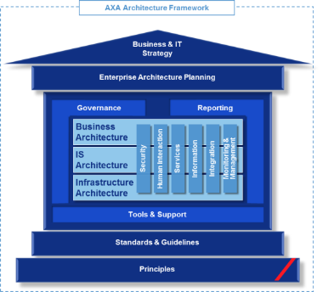
General Architecture design
AXA Asia Health Claims – IS Architecture and Vertical Architectures

Slide 2
Document History
Date | Version | Description | Distribution
3 Aug 2015 | 0.37 | Internal Architecture Team Review #1 (Business Architecture) | Youngran Kim, Regional Chief Architect Architecture Team (OneIT, ATS) Business Team
7 Aug 2015 | 0.38 | Internal Architecture Team Review #2 (IS / Infrastructure Architecture) | Youngran Kim, Regional Chief Architect Architecture Team (OneIT, ATS) Business Team
17 Aug 2015 | 0.38 | Internal Architecture Team Review #3 (Vertical Architecture) | Youngran Kim, Regional Chief Architect Architecture Team (OneIT, ATS) Business Team

Slide 3
Target Architecture

Slide 4

AXA Asia Target Architecture Blueprint 2016-2020+: Health Claims
CORE
Interface
Optional Interface
Distribution
Customer
Contact Center
Provider
Marketing
Partner Solution
Distribution CRM & Sales Management
(SFDC : Sales.cloud or Force.com)
Portfolio
Enquiry
&
Registration
Interaction
Self
Service
STP
SNS
Customer
Service
Site
Customer Service CRM
(SFDC : Service.cloud)
Service Provider
Corporate
WebSite
MOBILE
DIGITAL
BB1
CONTENTO
SWAP
And
UX
Management
PHP/Google
Campaign
Implemen- tation
Monitoring
Campaign
Planning
Analytics
Sales
Activity Mgmt
Lead / Campaign
Sales Aid
Document
eMail / Calendar
LIFE
P&C
Health
Network Provider
HCP
Policy
Claim
Payment
Corp/Employer
Sales Tool
MyAXA
WebSite & Mobile
(Contento and BB1)
Campaign Tool
Panel/Hospital
Analytics TOOL (DIL)
iConnect LIFE
iConnect P&C
iConnect Health
CTI Integration
Mobile/WEB
API Integration of 360 View of the Customer
IAM
Access/ Authorization
EIP -SoftwareAG.WebMethod
FAST IT Platform
BB1
Claims
Process/Rules Engine
(PEGA)
Core Policy Administration
Data Management
Core Database
MD
BIG DATA
LIFE Claim
(FileNet/WFI)
LIFE PRODUCT
APIs
AXA.xx
Contento
Life Core
Policy Administration
+ RCMS
RLSR29 (2014) R30 (2015)
Health Riders
Group & Health Core
Policy Administration
Health Retail/Group
Group/400 v7.6
Search (Elastic Search)
Mobile Factory
P&C Claim
(Guidewire)
P&C Product
Analytics
Risk
Finance
BlueMIX
Customer
24/7
Java OpenShift
Health / Group
(TBD: FINEOS)
Health / Group
P&C Core
Policy Administration
CSC Policy/SEA
(Policy/400)
LOCAL
Internal
External
Intelligence Engine
PHP/GOOGLE
AURA Medical AUTO
Underwriting
Customer
Behavior Data
Telematics
Social Behavior
Market
Finance Data
Java Script
[EB – Hong Kong]
Core Peripheral Systems
B2B Batch
Data
Exchange
SFDC
Banks
(HSBC, etc)
ETL
Reporting
Database
DIL : DATA LAKE
INTERNAL
EXTERNAL
INPUT
FAX/FILENET
Contents
Management
FILENET
OUTPUT
Thunderhead
INFORMATICA POWER/CENTER
INPUT
3rd Party
UDM (FILE EXCHANGE)
BIG Data Content Collector
Commodity Platform
Employee Portal
ONE
HR (YES)
Oracle Fusion
LMS
G/L
PeopleSoft
Sun Systems
G/L Copernic
SAP
Procurement
APS
Investment
Portfolio Mgmt
SHIP (SAP)
Actuarial / RISK
CAMP
PROPHET
FINANCE
MIS
(QlikView)
IT / Project Management
EA Tool, SDLC, PPM, CMDB, Testing
Service Ticket Management

Slide 5
Health Claims – Overall Architecture
Distribution
Customer
Contact Center
Marketing
Claims
Distributor Portal
Health Claims Portal
TPA
Provider Portal
Sales Toolkit
Distributor
Portal
Enquiry
Self
Service
Service
Sales
Campaign
Analytics
Portal
Mobile App
TPA
Portal
Provider
Mgmt.
Customer Interaction Integrator and 360 degree Customer View
Outgoing
Payment
Gateway
Integration Platform
Health Claims Management FINEOS
Local
EIP
Processes & Rules
Business API
Pre-Approval
Claims (Indemnity)
Claims (Cash)
Reimburse-ment
Request Pre-Approval
Record Document
Send SMS
Record Claim to PAS
View Document
Request Pre-Approval
MP
SMS
Gateway
Claim Assessment
Benefit Calculation
Leakage / Fraud
Care Provider Mgmt.
Local
Request Claim
Generate Document
Send Email
Record Payment to PAS
Preview Template
Compare Party w/ Restriction List
Generate and Record Doc.
Request Payment (auto)
Request Payment (check)
Record Shortfall to PAS
Product
Benefit Group
Package
Product
Data API
MC
Record Pre-Approval
Record Care Provider
Record Payment
Retrieve Interaction
Retrieve Participant
Benefit
Plan
Record Claim
Record Communication
Retrieve Policy
Retrieve Pre-Approval
Retrieve Document
Record Customer
Record Interaction
Retrieve Customer
Retrieve Claim
View Document
Customer
Policy
Activity
Case
Reporting
Platform
Core DB
Corporate
Claim
Document
Payment
Customer
Policy
Agent
Payment
BI
Master Data
Management
Corporate
Claim
Product
Interaction
Member
Invoice
Provider
Claim History
Data Mart
Reporting DB
Member
Complaint
Application
Billing
PAS
Local
Contents Mgmt.
FileNet
External Sanction
Norkom
Group/Health PAS
G/400
Group/Health PAS
EB
Life Policy PAS
RLS
Unstructured
DB
GI G/L
Sun
Life G/L
Peoplesoft
Output Mgmt.
Thunderhead (MCS)
Input Mgmt.
KOFAX / DATA CAPTURE
API Integration
Data Integration
Out-of-scope component
Capability
Data Element (Master Data)
Data Element (Interfacing Data)
Local
Local Component

Slide 6
Health Claims – Overall Architecture: Including Infrastructure & Security
Monitoring
Infrastructure
Distribution
Customer
Contact Center
Marketing
Claims
Application Performance Monitoring
ATS - DC
Distributor Portal
Health Claims Portal
TPA
Provider Portal
Sales Toolkit
Distributor
Portal
Enquiry
Self
Service
Service
Sales
Campaign
Analytics
Portal
Mobile App
TPA
Portal
Provider
Mgmt.
Customer Interaction Integrator and 360 degree Customer View
Network Gateway
Integration Platform
Health Claims Management FINEOS
Outgoing
Payment
Gateway
Local
EIP
Processes & Rules
Security Gateway
Business API
Pre-Approval
Claims (Indemnity)
Claims (Cash)
Reimburse-ment
Request Pre-Approval
Record Document
Send SMS
Record Claim to PAS
View Document
Request Pre-Approval
MP
SMS
Gateway
Claim Assessment
Benefit Calculation
Leakage / Fraud
Care Provider Mgmt.
Local
Request Claim
Generate Document
Send Email
Record Payment to PAS
Preview Template
WAF
Compare Party w/ Restriction List
Generate and Record Doc.
Request Payment (auto)
Request Payment (check)
Record Shortfall to PAS
Product
Benefit Group
Package
Product
ESG
Data API
MC
Record Pre-Approval
Record Care Provider
Record Payment
Retrieve Interaction
Retrieve Participant
Benefit
Plan
Email Gateway
Record Claim
Record Communication
Retrieve Policy
Retrieve Pre-Approval
Retrieve Document
Record Customer
Record Interaction
Retrieve Customer
Retrieve Claim
View Document
Mobile Gateway
Customer
Policy
Activity
Case
Reporting
Platform
Core DB
Corporate
Claim
Document
Payment
Customer
Policy
Agent
Payment
Member
Invoice
Provider
Claim History
Access
Authorization
CA SiteMinder
Policy Server
BI
Master Data
Management
Corporate
Claim
Product
Interaction
Data Mart
Reporting DB
Member
Complaint
Application
Billing
Policy Admin Systems
Agent
Local
Contents Mgmt.
FileNet
External Sanction
Norkom
GIR
Employee
Group/Health PAS
G/400
Group/Health PAS
EB
Life Policy PAS
RLS
Unstructured
DB
Customer
Pass AXA
UMC
GI G/L
Sun
Life G/L
Peoplesoft
Output Mgmt.
Thunderhead (MCS)
Input Mgmt.
KOFAX / DATA CAPTURE
CMDB
Server
Management
Storage
Management
Network
Management
Device
Management
Infra Application
Management
RWAN
Gateway
RWAN
Gateway
Country Infrastructure
API Integration
Data Integration
Out-of-scope component
Capability
Data Element (Master Data)
Data Element (Interfacing Data)
Local
Local Component

Slide 7
IS Architecture

Slide 8
Key Fundamental Architecture Principles
Maximized Business Value through Information
Drive IT initiative from business needs
Align info functionality within business capability groups
Support automated
and measurable business processes
Protect information
by adequate security measures
1
3
5
7
Consider information as assets of AXA
Design for customer centricity
Ensure the timely updating of all information
Ensure information ownership
2
4
6
8
Optimized Efficiency and effectiveness
Minimized Risks
Check the long-term costs and benefits
Reduction of heterogeneity
Take measures for reliable operations and fault tolerance
Usage of proven practices and technologies
9
18
Strive for Simplicity
Use the same solution patterns for the same kind of requirements
Analyze all changes for their effects and side-effects
Reuse before Buy before
Build
10
14
19
23
Follow the solution delivery processes
Prefer loosely coupled integration
Avoid bleeding edge technology
Reuse of components
15
20
24
Strive for modularity and reuse
11
Reduction of Maintenance Cost
Ensure sustainability
Legal constraints are taken into consideration
Avoid redundant information and functions
Avoid complexity or encapsulate it
Build components to be sustainable
Comply with AXA
rules and directives
12
16
21
25
Remove or mothball retired systems completely
Remove or mothball retired systems completely
Follow internal and industry standards
Comply with external regulations
13
17
22
26

Slide 9
Key Fundamental Architecture Principles
Conformance of Principles (1/3)
# | Principle | Enforcing Rationale
1 | Drive IT initiative from business needs | Health Claims project supports AXA Digital Ambition to leapfrog competitors by improving operating efficiency and enhancing customer experience. This is realized through the development of a regional platform which provides single claims system, automation, process management, and integration capabilities to support end to end claims processing.
2 | Consider information as assets of AXA | Through service integration capabilities, the Health Claims project makes information that currently residing in core back-end systems (i.e. claims data in PAS) more readily accessible to front-ends (e.g. customer portal) Claims architecture will enhance the 360 degree view of customer information with claims information and will therefore help to realize customer centric strategy
3 | Align information functionality within business capability groups | Health Claims provides business capabilities for claims processing, payment and service management. Information architecture will model data in corresponding subject areas to support these business capabilities and IS architecture will enable those via business process and system enquiry
4 | Design for customer centricity | Regional Master Processes are defined and automated process management capabilities are implemented to deliver an improved customer experience
5 | Support automated and measurable business processes | Business processes are designed to support automation and STP in order to augment overall business throughput, lower claims processing time and improve completeness and accuracy
6 | Ensure the timely updating of all information | Health Claims architecture will support 24/7 update and access of transactional information without any data synchronization delay
7 | Protect info by adequate security measures | Security architecture ensure adequate measures to be taken to protect data at-rest as well as data at movement by using techniques like message & data level encryption and encoding
8 | Ensure information ownership | Information Architecture will define proper data stewardship to own claims related data i.e. claims transaction data (FINEOS), policy data (Core DB) and customer data (Core DB)

Slide 10
Key Fundamental Architecture Principles
Conformance of Principles (2/3)
# | Principle | Enforcing Rationale
9 | Check the long-term costs and benefits | Business and IS architecture will ensure business processes are delivered at regional level with manageable variations for each country. Furthermore, the solution will ensure a very high level of conformant to out of the box functionalities of FINEOS. This will increase overall reusability, lower the maintenance cost and there by providing long term benefit
10 | Strive for simplicity | Simplicity in architecture is achieved by applying standardization in business architecture, separation of concern in IS architecture and pattern based approach in SOA integration
11 | Strive for modularity and reuse | Enhance modularization by adapting component based IS architecture along with reusable services to leverage enterprise data and information. For FINEOS the Health Claims will adhere to 80%-90% out of the box functionalities
12 | Avoid redundant information and functions | Architecturally no data is stored and managed in redundancy. Same approach is taken in order to define reusable services
13 | Fit all systems into the overall concepts | IS architecture is based on separation of concern principle that ensure defined role and responsibilities for each application in order to meet overall business requirements
14 | Use the same solution patterns for the same kind of requirements | Use of master process in business architecture, separation of concern and reusability in IS architecture and use of defined infra components for similar services
15 | Follow the solution delivery processes | Follow regional specified delivery methodologies for business, IS, information, integration and security architecture
16 | Avoid complexity or encapsulate it | Avoid complexity in applying process standardization for business architecture, right level of externalization in IS architecture, SOA principles for integration architecture, standard data model for information architecture and standard set of infra components for infra architecture
17 | Remove or mothball retired systems | Health Claims program provides claims processing functionality and the scope includes decommission of claims functionalities in PAS

Slide 11
Key Fundamental Architecture Principles
Conformance of Principles (3/3)
# | Principle | Enforcing Rationale
18 | Take measures for reliable operations and fault tolerance | Develop solution based on industry proven tools like Web Methods for EIP and Oracle/Informatica for Core DB/ETL and deploy them on standard fault tolerance VM technology based HW components
19 | Analyze all changes for their effects and side-effects | Proper impact analysis of target architecture and design to minimize impact on other regional programs like Connect IT and GTOM
20 | Prefer loosely coupled integration | Build integration architecture on SOA principles to enhance loose coupling between applications
21 | Build components to be sustainable | Build IS architecture of standard process architecture, integration on reusable SOA services that are based on industry standard data model and deployed on VM based infrastructure
22 | Follow internal and industry standards | Follow AXA standard like Master Process in business architecture, SOA in integration architecture and SAS model in information architecture and VM based components in infra architecture
23 | Reuse before buy before build | Avoid custom built solutions and use of industry leading tools to cover different aspects of architecture like FINEOS for Claims, Web Methods for EIP, Oracle/Informatica for Core DB/ETL, MCS (Thunderhead) for Output Management, FileNet, SiteMinder for security
24 | Avoid bleeding edge technology | Only use standard technology and tools for SW and HW
25 | Comply with AXA rules and directives | Define architecture based on AXA standard and guideline and go through formal approval processes before implementation
26 | Comply with external regulations | Conform to country level regulatory requirements such as data segregation,

Slide 12
Application Architecture
Interaction Touch points
Postal mails
Phone
Thin client
Thick client
Fax
email
SMS/MMS
Textual / Video chat
Tablets
Connected TV
Social Networks
Mobile / Smartphone
Web
Portal Services & multi-access enablers / Interaction services
UI integration & personalization
Channels / portal Front Ends
Customer behavior tracking
Web content Mgmt.
Collaboration services
Correspondence management
Offering & information push
Business Process Management / Process services
Orchestration
(process/workflow)
Process definition & maintenance
Process Execution & follow-up
Workload
management
Business Activity Monitoring
Mediation / gateway
Enterprise Content Management
Business Rules
Business Functions / Functional services
Integration
A. Strategy & Governance
B. Market Access
B.1 Customer Mgmt.
B.2 Distribution Mgmt.
B.3 Interaction Mgmt.
Security Services
Monitoring & Management
Adaptation
Content Acquisition
A.1 Strategy Development
B.4 Proposition Mgmt.
B.5 Marketing Mgmt.
B.6 Sales Mgmt.
Business Rules
Management
C. Core Business
A.2 Transformation Design
C.1 Product Mgmt.
C.2 Contract Mgmt.
Content Management
C.3 Commercial Risk Mgmt.
C.4 Service Mgmt.
Registry &
Repository
A.3 Corporate Governance
D. Business Support
Transportation
Product Configuration
Content Delivery
A.4 Corporate responsibility
D.1 Operations Mgmt.
D.2 Finance Mgmt.
D.3 Information Mgmt.
D.4 Technology Mgmt.
D.5 HR Mgmt.
D.6 Transformation Mgmt.
D.7 Procurement Mgmt.
D.8 Facilities Mgmt.
Information Services
Master Data Management
Real-Time & BigData
Analytics
Business Object services
Search services
Information
Stores
Application Data Stores
Unstructured Data
Operational Data Stores
Master Data Stores
Data Warehouse
BI Data Marts
BigData
Core module
Interfaced to a building block that can be reused or at least Interfaces can be standardized
Interfaced to a building block that can be reused
Interfaced to a local system, no shared solutions, some interfaces can be standardized, reuse is low

Slide 13
Application Architecture
Target Application Landscape
Security
TPA
24
Health Claims Portal / App
23
11
Authoization
(SiteMinder)
2
EIP
(Software AG webMethods)
Output Mgmt. (MCS, Thunderhead)
17
PAS (RLS)
7
Health Claims Administration
(FINEOS)
16
1
Security Policy
(SiteMinder
Policy Server)
Content Mgmt.
(FileNet)
18
Input Mgmt.
(Local)
19
Life G/L
(Peoplesoft)
10
12
Email GW
(Cisco Ironport)
PAS (EB)
20
WAF
(F5)
8
GI G/L
(Sun)
10
SMS GW
(Local)
13
20
ESG
(CA Layer 7)
PAS
(G/400)
9
Payment GW (Local)
20
14
Employee Directory
(GIR)
5
ETL
(Informatica)
Legend
15
Core DB
(Oracle DBMS)
Real time (EIP)
New
User Mgmt.
(Pass AXA)
3
Report DB
(SAS, Qlikview)
6
External Sanction
(Norkom)
25
Batch (ETL)
Existing
MDM
(Informatica)
4
Data int,
Integration

Slide 14
Application Architecture
Application Landscape Details (1/4)
# | Solution | Technology | Status | Scope |  | Description
 |  |  |  | Build | Infra
1 | Health Claims Administration | FINEOS | New | Build | New | Health Claims rules, UI, processes to be built New infrastructure
2 | EIP | Software AG webMethods | Existing | Extend / Integrate | Extend | New services supporting Health Claims process should be built EIP infrastructure (CPU / memory / machines) to be extended to support additional API volumes
3 | Core DB | Oracle DBMS | Existing | Extend / Integrate | Extend | Additional entity and attributes to be built for supporting Health Claims project scope Infrastructure to be extended to support additional volumes
4 | MDM | Informatica v9.1 | Existing | Extend / Integrate | Extend | MDM to be activated to support Customer creation MDM infrastructure to be extended to support additional volumes
5 | Data Workplace | Informatica ETL | Existing | Build | Extend | ETL process to support Core DB changes in Data Workplace Data migration support Infrastructure to be extended
6 | Reporting DB | SAS Enterprise BI Platform/ Enterprise Guide, Qlikview | Existing | Build / Integrate | Extend | New data mart to be built Infrastructure to be extended
7 | Life Policy Administration | RLS | Existing | Extend / Integrate | N/A | Integration program to be built No changes in infrastructure as same volume of transaction will be processes

Slide 15
Application Architecture
Application Landscape Details (2/4)
# | Solution | Technology | Status | Scope |  | Description
 |  |  |  | Build | Infra
8 | Group Policy Administration | EB | Existing | Extend / Integrate | No change | Integration program to be built No changes in infrastructure as same volume of transaction will be processes
9 | Group Policy Administration | G/400 | Existing | Extend / Integrate | N/A | Integration program to be built No changes in infrastructure as same volume of transaction will be processes
10 | General Ledger | Life : Peoplesoft GI : Sun | Existing | No change | No change | No changes – same integration between Policy Admin System to GL No changes in infrastructure as same volume of transaction will be processes
11 | Authentication / Authorization | SiteMinder | Existing | Extend / Integrate | Extend | SiteMinder Agent configuration to be defined to protect Health Claim Infrastructure to be extended to support additional transactions
12 | WAF | F5 | Existing | Extend / Integrate | Extend | Health Claims WAF configuration to be defined Infrastructure to be extended to support additional transactions
13 | ESG | CA Layer 7 | Existing | Extend / Integrate | Extend | ESG configuration to be defined to expose EIP services Infrastructure to be extended to support additional transactions
14 | Employee Directory | GIR | Existing | No change | No change | GIR group configuration to be defined No change for infrastructure
15 | User Management | Pass AXA | Existing | No change | No change | No change for Pass AXA

Slide 16
Application Architecture
Application Landscape Details (3/4)
# | Solution | Technology | Status | Scope |  | Description
 |  |  |  | Build | Infra
16 | Security Policy | SiteMinder Policy Server | Exists | Extend / Integrate | Extend | Health Claims Security Policy configuration to be defined Infrastructure to be extended to support additional transactions
17 | Output Management | MCS Thunderhead | Existing | Extend / Integrate | Extend | New templates for outgoing documents to be defined Infrastructure to be extended to support additional transactions
18 | Content Management | Life: FileNet 4 GI: FileNet 5 for GTOM, Local system | Exists | Extend / Integrate | Extend | Content acquisition process to be built to integrate with FINEOS GTOM FileNet should be used. Local system process should be changed
19 | Input Management | Life: Kofax GI: Local | Exists | Extend / Integrate | No Change | Content acquisition process to be built to integrate with FINEOS GTOM FileNet should be used. Local system process should be changed
20 | Email Gateway | Cisco Ironport | Exist | Integrate | Extend | Infrastructure to be extended to support additional transactions
21 | SMS Gateway | Local Component | Exist | Integrate | Extend | No changes to existing local SMS Gateway
22 | Payment Gateway | Local Component | Exist | Integrate | No Change | No changes to existing local Payment Gateway

Slide 17
Application Architecture
Application Landscape Details (4/4)
# | Solution | Technology | Status | Scope |  | Description
 |  |  |  | Build | Infra
23 | Health Claims Portal / Mobile App | Java | Existing | Integrate | No Change | Project delivers the APIs for Health Claims Portal. Integration is required to and from Health Claims Portal to Health Claims system.
24 | Third Party Administration | Local Component | Existing | Integrate | No Change | Integration is required to and from TPA to Health Claims system.
25 | External Sanction | Norkom | New | Build | New | Integration for FINEOS to compare claims with restricted list (e.g. provider, member, agent) New infrastructure

Slide 18
Data Architecture
Data Architecture Framework & Actualization
Data Access
& Analysis
Applications (OLTP simple query)
OLAP Data
analysis
Statistical Analysis & Data mining
Reporting (interactive & publishing)
Dashboard
Information
Services
Master Data Management
Meta Data Management
Real-Time & BigData
Analytics
Business Object services
Search services
Core Data Services
Data Structure
Profiles
Mapping, Matching and transform rules
Data Models
Security Services
Monitoring & Management
Data Recovery Services
Data Governance
Data Quality Management
Data lifecycle management
Data Stewardship
Information Stores
Application Data Stores
Unstructured Data
Core DB
Master Data Stores
Data Warehouse
BI Data Marts
BigData
Core module
Interfaced to a building block that can be reused
Interfaced to a building block, that can be reused or at least Interfaces can be standardized
Interfaced to a local system, no shared solutions, some interfaces can be standardized, reuse is low

Slide 19
Data Architecture
Detailed Logical Data Relationship
INSURANCE
AGREEMENT
(POLICY)
PARTY
PRODUCT SPECIFICATION
Insurance Agreement
Product Component
Master policy
Insurance Policy
Agent Role
Party Account
Producing Agent
Product Spec
Plan Spec
Agreement Deductible
Health Agreement
Agreement Exclusion
Servicing Agent
Party
Product Attributes
Agreement Limit
Agreement Benefit
Person
Organization
Package Spec
Agreement x Insured
Limit
Insured Role
Insured can be assigned to one or more health agreement dtls
Deductiibles
Employee
Member Excl.
Benefit Spec
Dependent
Party Address
Party Relationship
Exclusion
CLAIM
SERVICE AGREEMENT
ACTIVITY (TBD)
Related claim
Diagnosis
Service Provider Role
Activity Role
Medical Activity
Claim Master
Person
Organization
Patient
Medical Assessment
Claim service provider
Participate in panel contract
Direct contract
Claim Transaction
Service Agreement
Medical Treatment
Medical Transportation
Panel Service agreement
Doctor Service agreement
Claim Unit
Medical Unit Booking
Referral Consultation
Claim Trans Line Items
Claim
Document
Service provided
Related activity

Slide 20
Product Model
To-Be Logical Product Model vs. As-Is Policy Structure with Product Specifications Mapping Results
As-Is Policy Structure with Product Specifications
Logical Product Model
RLS
G400
EB
Product Component
RLS Model
Example
G400 Model
Example
EB Model
Example
Product
Policy
Global Elite II …
Policy
Porta Protection …
Policy
Flexi Plan …
Plan / Class
Basic Health
--------------
Rider Policy
Coverage
HOSP, CLIN, DENT …
Plan
Package + Class
(A, B, C …)
A (HOSP) …
Package
Plans are assigned at this level
Plan
A, B C …
Benefit
Ben. / Prod. specifications
R&B …
Benefit
R&B …
Benefit
HOSP-R&B …
Attributes
Limit
Row based structure
Members are assigned plan code and coverage, and benefits
e.g. A (HOSP) > R&B
Row based structure
Members are assigned coverage, plan code, and benefits
e.g. HOSP > A > R&B
Column based structure
Members are assigned plan with corresponding benefits
e.g. A > Hosp > R&B
Deductibles
Exclusion

Slide 21
Product Model
To-Be Product Specification Model
System
Components
Product Specification
Policy Admin System Components
(G400/RLS/EB)
Product
Product
Package / Class
Package
(Clinical)
Package
(Hospital)
Package
(Dental)
Class 1
Class 2
Health Claims System
Components
(FINEOS)
Benefit Group
Benefit
(R&B)
Benefit
(Surgical)
Benefit
(X-Ray)
Limit
Deductible
Benefit
Benefit
(Chest)
Benefit
(Heart)
Options

Slide 22
Product Model
Product Configurator Status
Currently, there is no automatic provision between Product Configurator and FINEOS. Product Developer needs to configure both Product Configurator and FINEOS.
 | Product Configurator | Automatic Provision | Configuration Contents
Life Product (w/o Health) | Life Product Configurator (PEGA) | RLS DLFE | Plan, Benefit, Charge, Distribution, Premium, Fund, Benefit, Eligibility, Operation
P&C Product | GTOM Product Configurator (PEGA) | GTOM | Plan, Benefit, Premium
 | Guidewire | - | Plan, Benefit
Group Health Product | [AS-IS] G/400 | - | Product, Plan, Benefit, Package, Benefit Group
 | [AS-IS] EB | - | Product, Plan, Benefit, Package, Benefit Group
 | FINEOS | - | Product, Plan, Benefit, Package, Benefit Group
 | [TO-BE] Group Health Product Configurator (PEGA) | G/400 | Product, Plan, Benefit, Package, Benefit Group
Individual Health Product | Life Product Configurator | RLS DLFE | Plan, Benefit, Charge, Distribution, Premium, Fund, Benefit, Eligibility, Operation
 | FINEOS | - | Product, Plan, Benefit, Package, Benefit Group

Slide 23
Product Model
To-Be Product Configuration Scenario
Life Product Developer
P&C Product Developer
Group Health Product Developer
Individual Health Product Developer
BPM / BRE
Pega
Life Product Configurator
P&C Product Configurator
Group Product
Configurator
Health Claims
Management
FINEOS
Health Benefit Configurator
Plan
Benefit
Plan
Benefit
Product
Plan
Product
Plan
Charge
Distribution
Premium
Package
Package
Benefit
Premium
Fund
Benefit
Benefit Group
Eligibility
Operation
Benefit Group
Data Provision
Data Provision
Data Provision
BPM / BRE
Pega
Life Policy
Admin
RLS
BPM / BRE
Pega
Group
Policy
Admin
G/400
Group Policy
Admin
EB
Local
DLFE
GTOM
Plan
Benefit
Plan
Benefit
Plan
Product
Plan
Product
Plan
Charge
Distribution
Charge
Distribution
Benefit
Package
Benefit
Package
Benefit
Premium
Fund
Premium
Fund
Premium
Benefit Group
Benefit Group
Eligibility
Operation
Eligibility
Operation

Slide 24
Data Architecture
High-level data flow at the process PoV, highlighting sub-processes with such requirements.
Data Requirements Summary
Member details (from Admin) (Insured, Owner, Beneficiary)
Company, Subsidiary (from Admin System)
Agent details, mainly for communication and fraud validation
Policy & Coverage details (Current & Historical Data) (from Admin)
Exclusions (from Admin)
Benefit Details (for group from Admin)
Network/Care Provider Details (from Claim system)
Payment details (from Claim system)
Payment status (from external payment Channels)
Additional Requirements incase of pending documents/Information (from Claim system)
Claim details (from Claims system)
Image details (from Imaging system)
Pre-Approval
Claims
Reimbursement
Care Provider Mgmt.
Non-core
Pre-Approval Input
Input Claim
Reimbursement
Care Provider Registration
Reporting
Pre-Approval Validation
Formal Validation
Formal Validation
Mass Processing
Follow-up – Case Observation
Care Provider Validation
Care Provider Validation
Suspicion for Fraud
Cancel Pre-Approval
Customer Investigation
Closed File Review
Pre-Approval Rejection
Policy Validation
Claim Assignment
Change Pre-Approval
Follow-up – Additional data
Output
Benefit Calculation
Update Payment Status
Cancel Claim
Claim Adjustment
Claims Ex-Gratia Payment
Create/change Reserved Claim Amount*
Process with data requirements
Claim Rejection
Process with no data requirements

Slide 25
Data Architecture
High-level data flow (1/4)
Pre-Approval
Claims (Indemnity & Cash)
Reimbursement
Care Provider Mgmt.
Non-core
Input (Pre-Approval)
Validation (Pre-Approval)
Output (incl. Follow-up)
Follow-up – Case Observation
Data coming from outside
Pre-approval data from portal(s)
Meta data from imaging archive
Image(s) from imaging archive (pdf)
Policy header
Benefit structure from policy / product on policy
Special conditions on policy (exclusions, amendments, pre conditions)
Member / group data (incl. black/grey lists)
Pre-approval participant(s) contact (member, care provider, agent, corp. HR)
Meta data from imaging archive
Image from imaging archive
Pre-approval participant(s) contact (member, care provider, agent, corp. HR)
Data stored within FINEOS
N/A
Benefit structure representation information
Care provider, network, panel
agreements with care providers and panels
Black / grey lists on providers
N/A
Pre-approval data
Data going outwards
N/A
N/A
Pre-approval data to output
Pre-approval participant(s) contact (member, care provider, agent, corp. HR) to output solution
Updated meta data on existing images & output documents imaging archive (incl. meta data)
Pending Information to output solution
Pre-approval participant(s) contact information (member, care provider, agent, corp. HR) to output solution

Slide 26
Data Architecture
High-level data flow (2/4)
Pre-Approval
Claims (Indemnity & Cash)
Reimbursement
Care Provider Mgmt.
Non-core
Input (Claims)
Formal Validation
Care Provider Validation
Customer Investigation
Data coming from outside
Claims data from portal(s)
Meta data from imaging archive
Image(s) from imaging archive (pdf)
Policy identification info
Member identification info
Member group identification info
Meta data from imaging archive
N/A
Special conditions on members (e.g. segment)
Member info
Member group info
Black/grey list info on members
Data stored within FINEOS
N/A
Care provider, network, panel identification info
Pre-approval info
Care provider, network, panel info
Black / grey list info on care providers
Info on agreements with care providers and panels
Claims info
Claims info
Data going outwards
N/A
N/A
N/A
N/A

Slide 27
Data Architecture
High-level data flow (3/4)
Pre-Approval
Claims (Indemnity & Cash)
Reimbursement
Care Provider Mgmt.
Non-core
Policy Validation
Follow-up – Additional data
Benefit Calculation
Output
Data coming from outside
Policy header info
Premium payment / shortfall info
Special conditions on policy (amendments, preconditions, exclusions)
If available, policy image(s) from imaging archive (pdf)
Meta data from imaging archive
Image(s) from imaging archive (pdf)
Claims participant(s) contact (member, care provider, agent, corp. HR)
Benefit structure info from policy / product on policy
Special conditions on policy (exclusions, amendments, pre conditions)
Claim participant(s) contact (member, care provider, agent, corp. HR)
Data stored within FINEOS
N/A
Claims info
Benefit structure representation information
N/A
Data going outwards
N/A
Pending info to output solution
Claims participant(s) contact (member, care provider, agent, corp. HR) to output solution
N/A
Claim data to output solution
Claim participant(s) contact (member, care provider, agent, corp. HR) to output solution
Updated meta data on existing images & output documents imaging archive (incl. meta data)

Slide 28
Data Architecture
High-level data flow (4/4)
Pre-Approval
Claims (Indemnity & Cash)
Reimbursement
Care Provider Mgmt.
Non-core
Reimburse -ment
Ex-Gratia Payment
Care Provider / Panel Mgmt
Reporting
Data coming from outside
Payment info on claim participant(s) (member, care provider, panel, corp. HR)
Claim participant(s) contact (member, care provider, panel, corp. HR)
Payment status (after successful payment)
N/A
N/A
Data stored within FINEOS
N/A
N/A
N/A
Data going outwards
Claim payment items
Payment info on claim participant(s) (member, care provider, panel, corp. HR)
Claim participant(s) contact (member, care provider, panel, corp. HR)
Care provider, panel, network info broadcasting (e.g. consumed by a portal)
Care provider, panel, network info
Claims (details incl. costs) info
Workflow information (TBD – RMIS, MIS, Others)

Slide 29
Data Architecture
Data Integration / Migration Approaches are as below. Options for claims data migration should be considered.
BI /
Analytics
Services (API)
Claims Data Migration Options
Reporting
Platform
4
Business
Intelligence
<<API>> Customer, Policy, Corporate, Member
1
Claim History Migration
Health Claims Management FINEOS
Details : Migrate as-is claims data and history data into FINEOS. Past and new claims will be processed through FINEOS.
(+) FINEOS will be able refer to claims history data for limit and benefit calculation without interfacing
(+) Maximized fraud prevention through broad data at customer / policy level
(-) FINEOS data capacity will need to be extended to contain claims history data
Reporting
DB
Transactional DB
Data Mart
Reporting
DB
Core DB
Customer
Policy
Activity
Case
Customer
Policy
Agent
Payment
Corporate
Claim
Document
Payment
Master Data
Management
Corporate
Claim
Product
Interaction
Member
Invoice
Provider
Member
Complaint
Application
Billing
Data Workplace
Data Gathering &
Extraction and
Distribution
3
Recommended Approach
Data Workplace
2
Policy Balance Migration
Staging DB
Workplace
DB
<<Migration>> Claim, Provider, Product
ETL
Details : Migrate the up-to-date balance data into FINEOS. Past and new claims will be processed through FINEOS.
(+) FINEOS will be able to have total amount claimed vs. total limit on policies to determine if incoming claims are validated
(-) Balance information will not include claims details to determine benefit level limits on incoming claims
1
<<ETL>> Customer, Policy, Agent, Payment, Billing, Corporate
Life Policy
Administration
RLS
Group & Health
Policy Admin
EB
Group & Health
Policy Admin
G/400
Data Integration / Migration Details
# | Type | Data | Comment
1 | ETL | Customer, Policy, Agent, Payment, Billing, Corporate
2 | File | Accounting | As-is interface
3 | Migration | Claim, Provider, Product | One-time migration
4 | API | Customer, Policy, Corporate, Member | Data loaded to FINEOS via API upon claim registration
Local
Customer
Agent
Payment
Customer
Agent
Payment
Customer
Agent
Payment
Policy
Product
Billing
Policy
Product
Billing
Policy
Product
Billing
3
No Migration
Claim
Provider
Claim
Provider
Corporate
Claim
Provider
Corporate
Details : Do not migrate any claims data into FINEOS. Any claims made prior to FINEOS → as-is processes / systems.
(+) No migration and analysis efforts to migrating claims history into FINEOS
(-) No information on claims made previous to go-live of FINEOS
(-) No limit / benefit calculations for no interface will be provided to retrieve such data from Core DB
Legend
2
<<File>> Accounting
<<File>> Accounting
To-be Obsolete
<<File>> Accounting
Life G/L
Peoplesoft
GI G/L
Sun
Master Data
Copied Data
Accounting
Accounting

Slide 30
Infrastructure Architecture

Slide 31
Infrastructure Architecture
Infrastructure Framework & Implementation Approach
Application Platform Services
Implementation approach
Reuse existing assets: | EIP (Software AG webMethods) ECM (FileNet) Thunderhead SiteMinder Web Content Management (AXA.xx) ESG | Informatica RLS / G400 / EB Core DB GIR
Build: | None
Buy or lease: | FINEOS
Hosted by AXA Tech: | FINEOS EIP (Software AG webMethods) ECM (FileNet) Thunderhead SiteMinder | Informatica RLS / G400 / EB Core DB ESG
Managed by AXA Tech: | EIP (Software AG webMethods) Oracle DBMS RLS / G400 / EB | SiteMinder ESG GIR
Hosted by other: | None
Application Hosting
Development
End user services
Web Servers
Development Environments
End User Application Delivery
Application Servers
Development Tools
End User Devices
Transaction Monitors
Code Repositories
End User Access Services
Life Cycle Management
Common Infrastructure Services
Database Services
Messaging Services
Enterprise Integration Services
Directory Services
Operating Environments
Operating Systems
Runtime Engines
Infrastructure Services
Virtualisation Services
Hypervisors
Device Virtualisation Services
Application Virtualisation Services
Core Infrastructure Services
Network
Server
Compute and Storage Services
Enterprise I/O Hardware
Data Centre Facilities Services
Data Centre
Physical Security
Power
Environment
Data Centre Space Management
Data Centre Building Management
Reuse shared technology provided by AXA
New instance of existing technology provided by AXA
New instance of new technology provided by AXA
Provider external to AXA

Slide 32
Infrastructure Architecture
Infrastructure Design Specifics
Area | Name | Description | Proposed Approach | Rationale
Infrastructure | FINEOS Deployment Model – Configuration | FINEOS to be deployed in single or multi configuration | Single configuration | Promote maintainability, and ease of deployment
 | FINEOS Deployment Model – Tenancy | FINEOS to be deployed in single or multi tenancy | Single tenancy (this also implies individual database per entity) | Data segregation
 | Database | Use of RAC or VM | VM and will rely on Hypervisor for resilience | AXA’s standard for database deployment
 | Peripheral System Servers | Upgrade of servers for all peripheral system | Additional storage for FileNet, and additional servers for MCS | Number of claims documents (10MB per claim) and correspondence

Slide 33




Infrastructure Architecture
With NO EXTERNAL INTERNET
access to FINEOS
Health Claims Infrastructure Architecture Diagram (RDC Production Environment)
Front-end (AXA Intranet)
Group Shared Service
Tier 3
Internal LDAP
External LDAP
Open LDAP (Directory Server)
GIR (Oracle Directory Server)
Policy Admin Systems
Open LDAP is a repository for distributors / customers
Load Balancer
Native Adapter (TCP+UDP)
RLS
G400
EB
Tier 1
Tier 2
Reverse Proxy (SiteMinder Agent)
LDAP
LDAP
Internal
users
FINEOS Server Cluster
(JBOSS)
FINEOS Database Cluster
(Oracle VM)
Core DB
HTTPS
HTTPS
WAF (F5)
HTTPS
HTTP
Application Server (VM)
JDBC
ETL
Oracle DB
HTTP
Hong Kong
India
Web Application Firewall
protects FINEOS from web based threats
DB 1
DB 2
DB 3
DB 4
DB 5
ETL allows E2E data integration
Front-end (Internet)
Load Balancer
Application Server (VM)
Hong Kong
India
SOAP/ HTTP
EIP (WM ESB)
EIP integrates applications
and provides data / business APIs to internal / external users
Application Server (VM)
Load Balancer
JDBC
Front-end / Partners
Malaysia
Thailand
General Ledger
XML / SOAP
Regional SMTP Gateway
SMTP
Application Server (VM)
Output Management
(MCS)
GI (Sun)
ESG
Singapore
Thailand
Life (Peoplesoft)
SMTP
ESG protects against SOAP/XML/JSON based threats and validates message against meta information
Application Server (VM)
CMS/ HTTP
Singapore
Malaysia
Content Management
(FileNet)
Input Management
(IBM DataCap)
External Payment GW
Load Balancer
HK
Group Shared Service
Legend
SG
External LDAP
Security
Integration (Direct / EIP)
IN
SiteMinder Policy Server
Application
External Integration
TH
SiteMinder Policy Server contains security policies to authenticate distributors access of protected resources
Integration
Internal Integration
ID
MY
Back-end

Slide 34
Infrastructure Architecture
With NO EXTERNAL INTERNET
access to FINEOS
Health Claims Infrastructure Architecture Diagram (ID Production Environment)
Front-end (AXA Intranet)
Group Shared Service
Tier 3
Internal LDAP
External LDAP
Open LDAP (Directory Server)
GIR (Oracle Directory Server)
Policy Admin Systems
Open LDAP is a repository for distributors / customers
Load Balancer
Native Adapter (TCP+UDP)
RLS
G400
EB
Tier 1
Tier 2
Reverse Proxy (SiteMinder Agent)
LDAP
LDAP
Internal
users
FINEOS Server Cluster
(JBOSS)
FINEOS Database Cluster
(Oracle VM)
Core DB
HTTPS
HTTPS
WAF (F5)
HTTPS
HTTP
Application Server (VM)
JDBC
ETL
Oracle DB
HTTP
Indonesia
Web Application Firewall
protects FINEOS from web based threats
DB 1
ETL allows E2E data integration
Front-end (Internet)
Load Balancer
Application Server (VM)
Indonesia
SOAP/ HTTP
EIP (WM ESB)
EIP integrates applications
and provides data / business APIs to internal / external users
Load Balancer
JDBC
Front-end / Partners
General Ledger
XML / SOAP
Regional SMTP Gateway
SMTP
Output Management
(MCS)
GI (Sun)
ESG
SMTP
Life (Peoplesoft)
ESG protects against SOAP/XML/JSON based threats and validates message against meta information
CMS/ HTTP
Content Management
(FileNet)
Input Management
(IBM DataCap)
External Payment GW
Load Balancer
HK
Group Shared Service
Legend
SG
External LDAP
Security
Integration (Direct / EIP)
IN
SiteMinder Policy Server
Application
External Integration
TH
SiteMinder Policy Server contains security policies to authenticate distributors access of protected resources
Integration
Internal Integration
ID
MY
Back-end

Slide 35
Infrastructure Architecture
FINEOS Deployment Components
FINEOS Application Server
FINEOS Application Server (JBoss)
No requirements for components to be co-located with configurability as necessary
All nodes can be deployed to virtual servers
FIENOS Application Nodes
FINEOS Claims: core web application for executing claims processes
FINEOS Reports Manager: provides views and technicality of report generation with functions to depict what information will be consisting of the reports
FINEOS Email Manager: application logically constructed to keep track, read, write, and send in/outbound correspondences
FINEOS Services: a WS composer to configure web services to define the requirements interfacing systems / services for the WS
FINEOS Analytics: runs in the background to recalculate scores with pre-defined scores that are expandable
FINEOS Case File: keeps record of all relevant information on every cases to generate document report on case
FINEOS Work Performer: execution of batch processes, can be processes parallel to claims processing (e.g. email batch, case file background process, reports)
User will only access the FINEOS application component with an exception of specific users that will directly access other components (e.g. score configurators access FINEOS analytics)
JBoss
<<Web application>> FINEOS Claims
<<Web application>> FINEOS Reports Manager
<<Web application>> FINEOS Email Manager
<<Web application>> FINEOS Services
<<Web application>> FINEOS Analytics
<<Web application>> FINEOS Case File
<<Java SE>>
FINEOS Work Performer

Slide 36
Infrastructure Architecture
Logical deployment of application is composed of 3 options. Case 3 is recommended for Health Claims.
Deployment Options
Case 1 : Partitioned Application
Case 2 : Country/Entity Separation
Case 3 : Common Application
Regional Configuration
Regional Master
Regional Configuration
HK (+MA)
MY
TH
IN
SG
ID
RO
HK (+MA)
MY
TH
IN
SG
ID
Common
Common
Publish Regional Configuration
Publish Regional Configuration
Publish Regional Configuration
Separate
Separate
Separate
Separate
Separate
Separate
HK (+MA)
MY
TH
HK (+MA)
MY
TH
IN
SG
ID
HK (+MA)
MY
TH
IN
SG
ID
HK (+MA)
MY
TH
IN
SG
ID
Shared (w/ partitions)
Separate
Common
Common
Common
HK (+MA)
MY
TH
IN
SG
ID
Separate
Separate
Separate
Separate
Separate
Separate
Common
Common
ID
SG
ID
HK (+MA)
MY
TH
IN
SG
ID
HK (+MA)
MY
TH
IN
SG
ID
HK (+MA)
MY
TH
IN
SG
ID
Common
Common
Common
Details
Regional master configuration is applied to the shared application (+ separate SG, ID)
Within the shared application, a logical partition is applied for complete segregate data amongst country/entity
Regional master is applied to separated instances (by country or entity)
All instances are completely segregated with no infrastructure, application, data shared
Regional master configuration is reflected for all countries/entities and activated based on ACL definition
Claims are assigned to entities
Pros
Best leverages most of FINEOS out-of-box functionalities with minimal customization resulting in minimized maintenance costs
Availability of country/entity specific configurations due to separated analysis, development, and implementation
Capable for single deployment instance
Maximum flexibility (entity specific)
Capable of risk mitigation through applying lessons learned from previous entity/ies
Cons
Duplicated customer info across partitions
Users require multiple identities
Entity specific masters need individual management efforts
Duplicated customer, provider info across country/entity instances (extra mapping efforts)
Claims does not have member single view interacting with multiple countries/entities
Entity specific masters need individual management efforts

Slide 37
Infrastructure Architecture
Physical deployment of application is composed of 3 options. Case 2 is recommended for Health Claims.
Deployment Options
Case 1 : Shared Instance (+ SG, IN)
Case 2 : Country Instances
Case 3 : Entity Instances
Master Configuration
Shared (HK, MY, …)
Master Configuration
HK (+MA)
Master Configuration
HK_LI (+MA_LI)
Master Config.
Master Config.
HK Config.
Master Config.
HK_LI Config.
HK_GI
Master Process
Country Config. (per country)
Master Process
MY
Master Process
Master Config.
HK_GI Config.
Master Config.
MY Config.
MY_LI
Org. Structure
Org. Structure
Org. Structure
Master Config.
MY_LI Config.
Singapore
IN
MY_GI
Master Config.
Master Config.
IN Config.
Master Config.
MY_GI Config.
Rules
Rules
Rules
TH
SG_LI
Security Group
SG Config.
Security Group
Master Config.
TH Config.
Security Group
Master Config.
SG_LI Config.
SG_GI
Indonesia
SG
Master Config.
SG_GI Config.
Product FW
Product FW
Master Config.
SG Config.
Product FW
AFI_LI
Master Config.
Master Config.
AFI_LI Config.
User Interface
User Interface
ID
User Interface
ALI_LI
ID Config.
Master Config.
ID Config.
Master Config.
ALI_LI Config.
Details
3 deployment instances
Single instance for 5 countries (HK, MA, IN, MY, TH)
Separate instances for ID and SG due to separate data center management (ID) and data privacy regulations (SG)
6 deployment instances
Instances are separated based on countries (total of 7 countries : HK (+MA), MY, TH, IN, SG, ID)
Satisfies the instance separation requirements for SG, IN
15 deployment instances
Instances are separated based on entities (total of 15 entities : HK_LI (+MA_LI), HK_GI, SG_LI, SG_GI, MY_LI, MY_GI, TH_LI, TH_GI, ...)
Satisfies the instance separation requirements for SG, IN
Pros
Highest cost efficiency due to the least number of instances
Country specific flexibility
Capable of risk mitigation through applying lessons learned from previous country/ies
Maximum flexibility (entity specific)
Capable of risk mitigation through applying lessons learned from previous entity/ies
Cons
Highest risk due to a single instance for multiple countries
Higher development, project management, and system go-live costs than the big bang approach due to more instances
Highest development, project management, and system go-live costs due to more instances

Slide 38
[Back-up] Infrastructure Architecture
Deployment Instances Separation
Regional Structure
REGION
HONG KONG
Life
AXA China Region Limited – Hong Kong
GI
AXA General Insurance Hong Kong Ltd
Key Notes
MACAU
Life
AXA China Region Limited - Macau
Current assumption stands for prioritized countries of implementation (Hong Kong, Singapore, India)
6 countries are capable of single instance where Singapore and India requires separate instances due to data regulations
15 physical entities exist amongst all countries
Macau will deployed along with Hong Kong without it being a separate instance
MALAYSIA
Life
AXA Affin Life Insurance Berhad
GI
AXA Affin General Insurance Berhad
THAILAND
Life
Krungthai AXA Life Insurance Company Ltd
GI
AXA Insurance Public Company Thailand
INDIA
GI
Bharti AXA General Insurance Company Limited
SINGAPORE
Life
AXA Life Insurance Singapore Pte Ltd
GI
AXA Insurance Singapore Pte Ltd
INDONESIA
Life
PT AXA Services Indonesia
AXA Life Indonesia
PT AXA Mandiri Financial Services
GI
PT Asuransi AXA Indonesia
PT Mandiri AXA General Insurance

Slide 39
Architecture Verticals

Slide 40
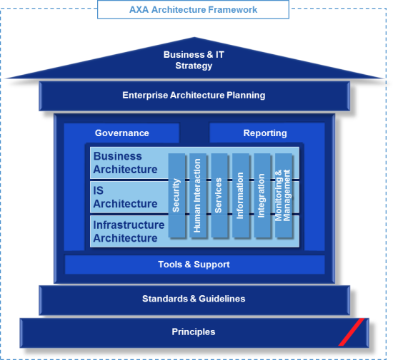
Vertical Architecture
IS Architecture |  | Infrastructure | Vertical Architecture
Application | Data |  | Security | Human Interaction | Service | Information | Integration | Monitoring & Mgmt.
AXA Architecture Framework
Security Vertical
Human Interaction Vertical
Services Vertical
Information Vertical
Integration Vertical
Monitoring & Management Vertical

Slide 41
Security Vertical
Security Services Framework
Administration
Data Protection
Encryption
Data loss prevention
Sanitization
etc.
Non-Repudiation
Digital Signature
Secure audit logs
etc.
Identity & Access Management Services
(see IAM service framework)
Data Classification
Resilience
Backup and Recovery
Replication
Redundancy
Content Control
Incident management
etc.
Network Protection
Firewalls and Proxies
Filter/content scanning
IPS/IDS
Next Generation Firewalls
Network access control (NAC)
etc.
Application Security
App testing & Scanning
Code Analysis,
Web Application Firewall
etc.
Audit/Compliance
Identity Mgmt.
Authentication
Authorization
Endpoint, Server, & Gateway Protection
Vulnerability
Patch & configuration management
Disk and file encryption
Data loss prevention
Device control (including device mgmt. & tracking)
etc.
Threat management
Penetration testing
Log inspection
Incident management
Security configuration management
Patch management
Security and threat intelligence
Vulnerability management
Data intelligence gathering
Integration and analysis
Trustworthiness evaluation
etc.
VIP
Repository
Reuse shared technology provided by AXA
New instance of existing technology provided by AXA
New instance of new technology provided by AXA
Provider external to AXA

Slide 42
Security Vertical
List of Internal Business Users of FINEOS
Division | Roles | Job Description
Claims Roles | Claims manager | Leads the claims team as well as handles complex and escalated claims
 | Claims data entry officer | Responsible for inputting manually data into the claims system
 | Claims assessor | Responsible for assessing non straight through processed claims depending on assigned authority level (assessors with different authority levels based on their expertise will exist in entities)
 | Pre-approval assessor | Responsible for inputting pre-approval data into the claims system as well as assessing non straight through pre-approvals
 | Medical expert | Assesses complex health claims that require additional medical expertise
Other Roles | Scanning officer | Responsible for sorting and scanning of claims related documents
 | Mail room officer | Responsible for packaging and distributing outbound mail as well as sorting incoming mail
 | Network administration | Setting up contracts and rate for care providers and assists the network manager as required
 | Network manager | Establishing and maintaining existing care provider relationships as well negotiating rates and agreements with care providers
 | Payment / settlement officer | Processes manual payment and trigger auto payments for bank transfer
 | Payment / settlement manager | Oversees activities of settlements officers and deals with more complex / high payment requests
 | Investigation specialist | Investigates suspiciously flagged and fraudulent claims
 | Customer care officer | Responsible for handling customer inquiries and complaints at AXA service centers or call centers
 | Underwriter | Provides a second opinion for a claims assessment. Underwrites the policy and assesses if a policy can be issued
 | FINEOS benefit administrator | Responsible for organizing and setting up new products as well as updating all medical catalogues

Slide 43

Security Vertical
Authentication Process
# | Principle
1 | Separate Security Controls from Business Logic and Data Access
2 | Use Identity and Access Management services
Architecture should comply with Group IAM Web Access Management and use IAM shared service
Web Application Firewall protects FINEOS web application from web based threats such as cross site scripting or SQL injection.
SiteMinder Agent handles authentication and authorization based on the security policy defined in SiteMinder Policy Server.
FINEOS receives user ID from SiteMinder Agent. FINEOS does not need to handle login.
Employee
Web Application Firewall F5
Authentication / Authorization SiteMinder Agent
Protect against Web Threat
Is User Authenticated?
Is User Authorized to Access?
Security
Policy
SiteMinder
Authorization Definition
Health Claims
Management
FINEOS
Grant Access
Employee
Directory
GIR
User Credential
User Group
Organization Structure

Slide 44

Security Vertical
Proposed IAM CoE has proposed two options for proceeding with POC with AXA Tech Asia
Authentication flow
Business flow
Option 1: Header Mode
NEDC - WAM Shared Service
SG RDC – AARO Shared Services
User tries to connect to FINEOS with no user context.
It is redirected to WAM Authentication Service to authenticating against WAM solution with appropriate authentication sequence. Authentication flow goes through WAM Reverse proxies located in Europe.
Once user properly authenticated, WAM builds a set of headers including the user identity and potentially a list of user groups or any information WAM is aware of / are useful for FINEOS for building user context.
End user is redirected back to FINEOS with user context.
WAM
Authentication Service
[User ID]
[User Groups]
Headers
3
2
WAM
Reverse Proxy
FINEOS
Authentication service
FINEOS Solution
End-Users
1
4
Option 2: Federation Mode
User tries to connect to FINEOS with no user context.
It is redirected to WAM Authentication Service to authenticating against WAM with the appropriate authentication sequence. Authentication service is located in the Europe.
Once user properly authenticated, WAM builds a SAML assertion containing user identity and potentially a list of user groups or any information WAM is aware of / are useful for the FINEOS solution for building user context.
SAML assertion is posted to FINEOS Authentication Service where SAML assertion is consumed and FINEOS builds user context accordingly.
End user is redirected back FINEOS with user context.
NEDC - WAM Shared Service
SG RDC – AARO Shared Services
WAM
Authentication Service
WAM
Federation Service
FINEOS
Authentication service
FINEOS Solution
[User ID]
[User Groups]
SAML Assertion
End-Users
2
3
4
1
5

Slide 45
Security Vertical
Data Security and Protection
Application
Access control is implemented to restrict access to FINEOS – authorization and authentication with connection to GIR and SiteMinder
Profile and permission is set up within FINEOS (e.g. entity level, user group (or department) level, secured actions & security groups)
FINEOS will only be accessed by internal AXA staff via the AXA Asia intranet
Network
ESG is set up to safeguard AXA’s internal systems for integration and data in transit to / from external system
3 tiers architecture is designed to ensure network segregation to external and internal access to data
Web Application Firewall is setup to protect FINEOS access from the local entities
Infrastructure
Separation of application instance per country within the Jboss VM
Separation of database instance per country i.e. 6 Oracle Database VM
Database
Data at rest is encrypted at database table level (Oracle database)
Physical and logical database schema is implemented to ensure compliance to country specific regulation requirement
Oracle TDE is applied to encrypt data

Slide 46


Security Vertical
End-to-End Security on Claim User Journey
Layer
Claims User Flow (w/ Secured Points)
Description of Secured Points
Front-End
Directory (GIR)
Claims user will log into client (desk top, laptop) in which retrieves user / user group information from GIR for employee directory and SiteMinder for authentication / authorization
Internal User
Intranet
Authentication (SiteMinder)
Health Claims (FINEOS)
FINEOS
Application server authenticates users against an LDAP directory, identified by GIR and protected by SiteMinder to define User/User Group in FINEOS
Department and Security Group define access authorization (e.g. function, configuration)
User
Department
User Group
Business & Data API
Security Group
EIP
EIP
GIR information regarding the user will be passed on through EIP but no security actions are required upon entrance of or within the EIP layer
Back-end & Database
Core DB & MDM
Authorization checks will be executed by the back-end systems that has direct integration with FINEOS
Respective User/User Group information will be stored in back-end systems to allow user access in forms of create, update, retrieve, archive depending on the details of corresponding APIs (e.g. request claim, record claim, retrieve customer, request payment)
Policy Admin
Output Mgmt.
Content Mgmt.
Email/SMS Gateway
Payment Gateway
Report DB
G/L
Input Mgmt.
Secured points w/ GIR info
Actions w/o security enforcement

Slide 47
Security Vertical
Identity Management – User Provisioning Process (options)
Administrator
Option 1 : Manual Registration
Standard behaviours for User Provisioning
Zero integration configuration / build
Current Working Assumption
Health Claims
FINEOS
Add user to FINEOS
2
3
Assign user groups
Common Process
…
<<user>>
Create user
<<user>>
Assign user group
Administrator
1
Add User to Directory
User
Group
Employee Directory
GIR
2
<<SOAP>> Create user
3
<<SOAP>> Assign user group
Option 2 : Directory Managed (Push)
User automatically created in Claims based on business rule
Supports User update & removal
Client owned integration / no customization
Recommended approach for one-touch User Provisioning
Health Claims
FINEOS
…
<<system>> Create user
<<system>> Assign user group
User
Group
Administrator
Option 3 : Directory Search (Customization)
Administrator searches Directory Groups for authorized users
Custom solution – LDAP queries defined for Customer Directory
Full Directory mirroring of groups requires additional custom components
Health Claims
FINEOS
2
Add user action
3
Assign user groups
<<user>>
Add user action
<<system>>
Retrieve user
<<system>>
Record user
<<user>>
Assign user group
4
LDAP Search
User
Group

Slide 48

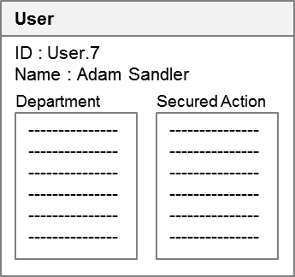
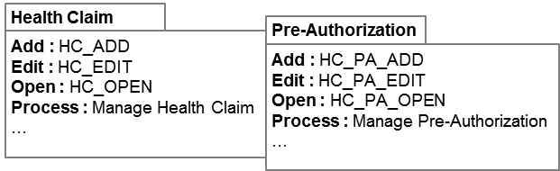
Security Vertical
Authorization
Workflow
Security
Workflow : Task driven representation of an organization
Security : Defines the security architecture based on secured actions and groupings of the secured actions
Department : Added to workflow to define grouped access to certain aspects / components of the application. Concept is applied to define group of users in a specific entity in a workflow perspective
Security Group : defines different group of users with security credentials to have access to different metrics (can be applied at the department or user/user group level)
Secured Action : 600+ secured actions in FINEOS will allow different grouping for the purpose of serving different departments and/or security groups
Queue : Work queue, case queue… the word Queue is applied to actions or tasks on the workflow
Case Type & Rules : case type defines the type of task for each case where rules can be applied to define which authorization group/user has access to add/edit/open/process the case (cases can be moved from department to another, once moved the previous department will not have access to the case)
User : user information is kept with the corresponding ID, Name, Department, and Secured Actions the user is authorized to for the purpose of complete his/her tasks
1
2
Hong Kong
Claims Entry
Group
4
Security Group
3
General
5
FO_ENTRY
User 1
CREATE_CLAIM
User 2
User 3
DO_TASK
…
…
Panel A
Provider Services
User 4
Security Group
User 5
ADD_PARTY
User 6
PASSWORD_EDIT
User 7
EDIT_PAYMENT
…
…
SERVICE_AGREEMENT
Life
…
…
…
Case Type & Rules
7
8

Slide 49


Security Vertical
Audit and Compliance – Application Audit / Security Audit
Hong Kong
User A
User B
Group
Application
4
Entity : Audit is executed at the entity level
TOC.CASE : Modifications at the database level keeps trails of the user that was responsible for the modification
HOC.CASE : logging of all the modifications as instance records. Logging and auditing is done for all actions taken for the application security schema
Application : history table
Security : security change history (log-in, log-out, change)
History Recalling : enabled at a click of a button to show who created the case, who modified it, who updated it, etc. for all deltas that are persisting to the case
2
3
TOC.CASE
….
….
…
HOC.CASE
….
….
…
Security
2
3
TOC.CASE
….
….
…
HOC.CASE
….
….
…
1
User A
User B
Life
Application
4
2
3
TOC.CASE
….
….
…
HOC.CASE
….
….
…
Security
2
3
TOC.CASE
….
….
…
HOC.CASE
….
….
…
…

Slide 50
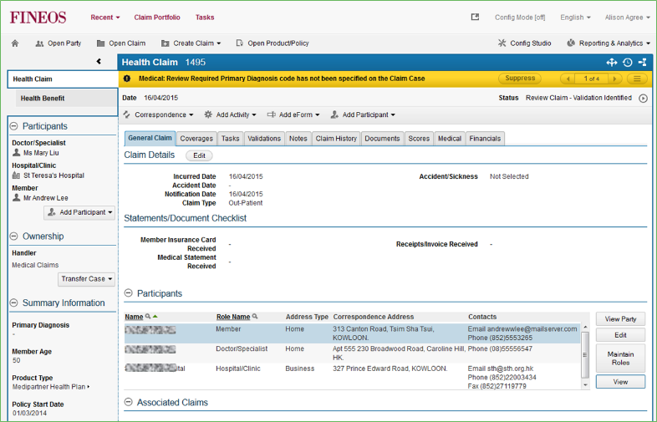
Human Interaction Vertical
FINEOS 8.4 Platform Client Environment
# | Principle
1 | Quick to build and change
2 | Minimize third-party solution customization for both packaged and SaaS solutions
Calculation and rules are centrally defined and managed in business rules layer. UI screen and flow can be changed in the UI configuration
Maximize the use of Out-of-the-Box FINEOS UI with minimum customization
FINEOS Out-of-the-Box UI Requirements
Browser Require-ments
IE11, Chrome, Firefox
Create Email & Open Document behavior are browser dependent
Configuration Studio is IE11 only
Operating System
Win 7 & Win 8.1
Hardware
Screen resolution – minimum width: 1024 pixels, (1200+ pixels recommended)
Dual Screen Capabilities
Dual screens / additional width are recommended in deployments with significant image integration

Slide 51
Human Interaction Vertical
Client Support vs. FINEOS version Matrix
Client Support | FINEOS Version
 | v7.0 | v7.1 | v7.2 | v7.3 | v7.4 | v7.5 | v7.6 | v7.7 | v8.0 | v8.1 | v8.2 | v8.3 | v8.4 | v8.5 | v8.6
Windows 2000
Windows XP | √ | √ | √
Windows Vista
Windows 7 | √ | √ | √ | √ | √ | √ | √ | √ | √ | √ | √ | √ | √ | √
Windows 8 |  |  |  |  |  |  |  | √
Windows 8.1 (w/ IE11) |  |  |  |  |  |  |  |  | √ | √ | √ | √ | √ | √ | √
Windows 10 (w/ IE11) |  |  |  |  |  |  |  |  |  |  |  |  |  |  | √
IE6 (32bit)
IE7 (32bit) | √ | √ | √
IE8 (32bit) | √ | √ | √ | √ | √ | √
IE9 (32bit) |  |  |  |  | √ | √ | √ | √ | √ | √ | √
IE10 (32bit) |  |  |  |  |  |  |  | √ | √ | √ | √ | √
IE11 (32bit) |  |  |  |  |  |  |  |  | √ | √ | √ | √ | √ | √ | √
Chrome & Firefox | √ | √ | √ | √ | √ | √ | √ | √ | √ | √ | √ | √ | √ | √ | √
Microsoft Office 2003 | √
Microsoft Office 2007 | √ | √ | √ | √ | √ | √ | √ | √
Microsoft Office 2010 |  |  | √ | √ | √ | √ | √ | √ | √ | √ | √ | √ | √ | √
Microsoft Office 2013 |  |  |  |  |  |  |  |  | √ | √ | √ | √ | √ | √ | √
√
Supported
√
Support Starts
Support Ends
FINEOS Version for Health Claims System
Browser Considerations:
IE8 and later versions must be run in Standards mode (compatibility mode/view off)
Google Chrome & Mozilla Firefox
Browsers are capable only for intranet deployments
No support for FINEOS Configuration Studio and opening MS Word documents in edit mode directly from browser (editing documents can be done using web folders view of documents)
No support for viewing processes graphically

Slide 52
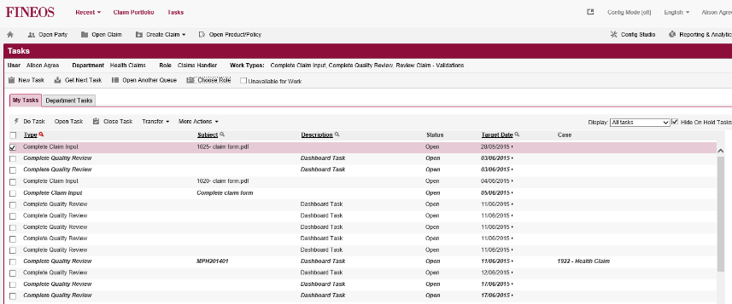
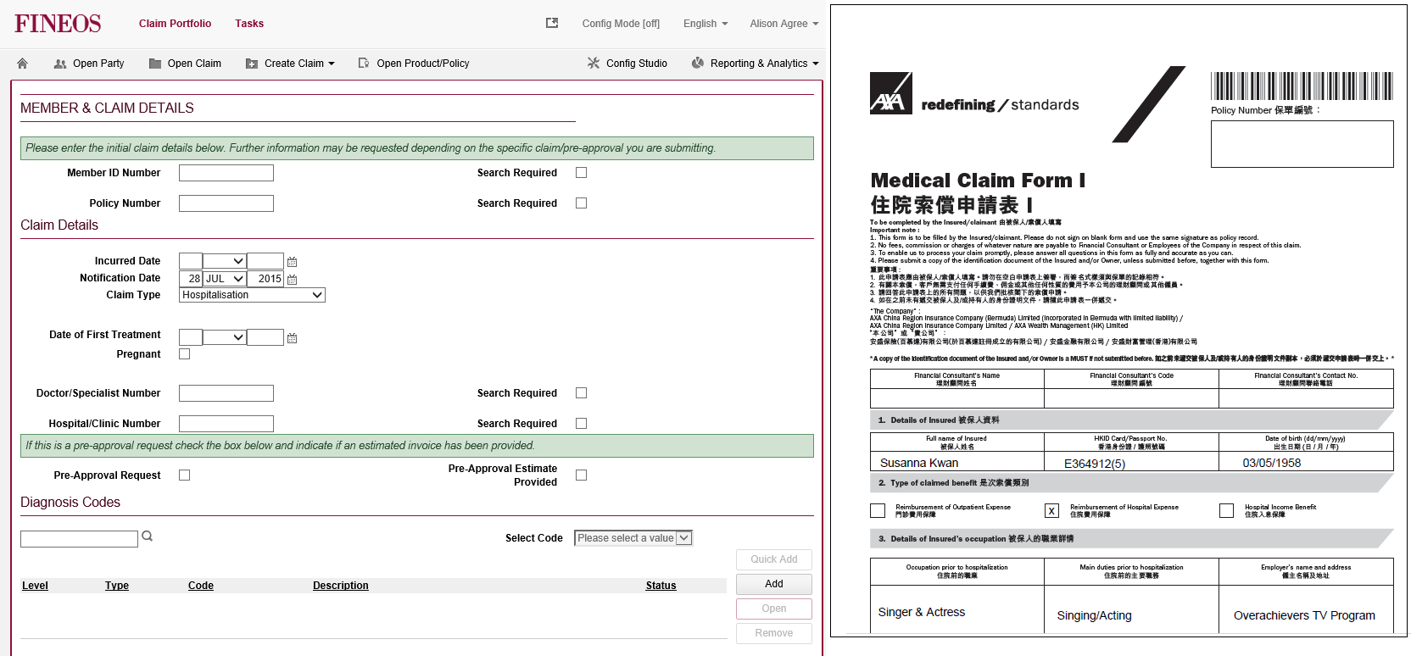
Human Interaction Vertical
[Back-up] FileNet user view via link (Dual Screen Entry)
1
2
Upon selection of task FINEOS will move to the next UI with task details including member information, claims information, diagnosis information etc.
Along with the task information, FINEOS will triggers FileNet view which calls out for viewing of task related documents rather than physically retrieving the documents
Current screen / HW requirements indicate an assumption that 50% of users will work with two screens → this means that for 50% of the users an additional screen needs to be considered in budget estimation

Slide 53

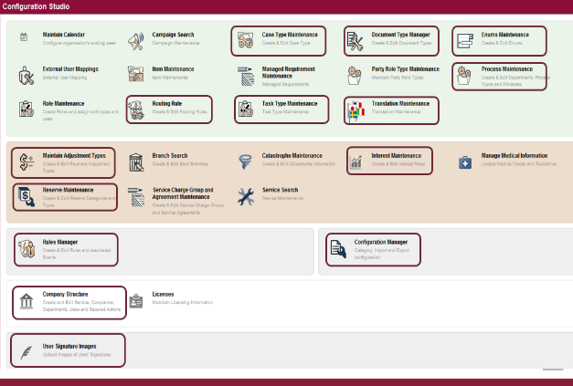
Human Interaction Vertical
FINEOS Configurability (Out-of-the-Box Configurator)
FINEOS Health application can be configured using the built-in UI configurator
User Interface components (e.g. screen panels, data elements, contents)
Workflow queues
Application look and feel
FINEOS Configuration Studio enables:
Build or modification of screen navigation to support claims processing, e.g. payment wizard
Make screens more user friendly to pretend errors in data entry
Include data validation for specific fields
Build hard and soft alerts to help the users in their daily work
Design different views for ad-hoc reports
Workflow configuration capabilities to redesign UI flow to the optimal choice of AXA Asia
Assign tasks automated tasks, rule based decisions, rule based data creation, and notification upon task completion
As part of the detailed solution assessment workshops, the project team has not requested any significant changes to the FINEOS UI and hence it is expected that the out of the box layouts will be utilized to a large extent

Slide 54
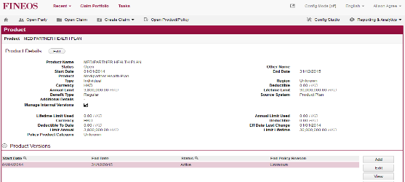
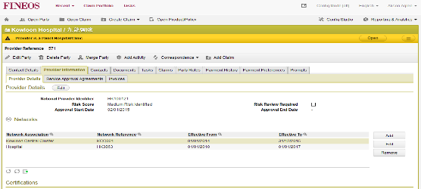
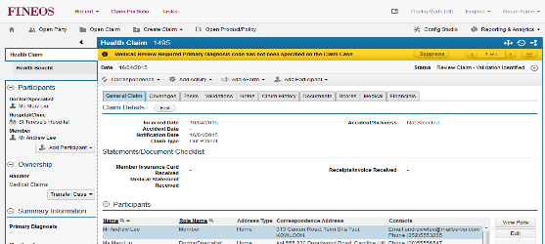
Human Interaction Vertical
FINEOS UI is categorized into different “Zones” in respect to the different tasks that are being executed.
Introduction to Application Zones
A user is considered to be within a particular Zone if they are working within the logical confines of a particular subject such as a Case or a Party. A single zone may span a number of Pages, thus providing a higher abstraction level on the information displayed by the application. Being in a Zone triggers some changes in the behavior of the application:
Policy Zone
Party Zone
Zone header: This is used to ensure that the user is more aware of where they are within the application. Different header colors will be assigned for different zones to provide visual orientation indicators to the user.
Key Information (Optionally configurable): This is used to display relevant information about the main object of the current Zone
Case Zone
Collapsible Panel (Optionally Configurable): This is used to display additional widgets with information of the Zone across all the pages of the Zone, so the information is quickly accessible by the user.

Slide 55
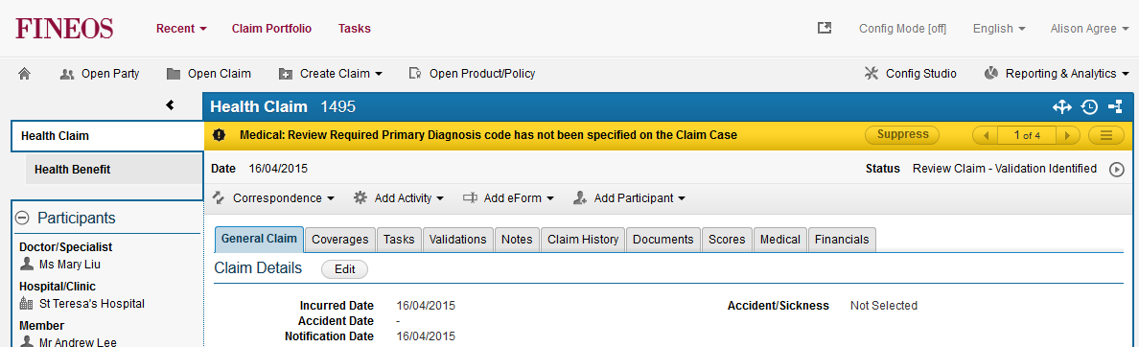
Human Interaction Vertical
When user enters a new Zone, in the following example a “Case Zone”, the Zone layout configured in the application is applied. This changes the view to the following.
1
3
4
2
5
Zone Header Bar: in this sample displaying the name and code of the Case. This is fully configurable and developers can create their own widget to display the header.
Key Information Bar: in this sample showing details about the case. This is fully configurable and developers can create their own widget to display the relevant information.
Collapsible Panel: a panel that contains widgets with data on the Case. This is fully configurable and developers can create their own widget to display the widgets we want.
Case Map: a product panel widget that shows the Case hierarchy, including parent and child cases.
Participants: a product panel widget that shows the roles involved in this Case.

Slide 56
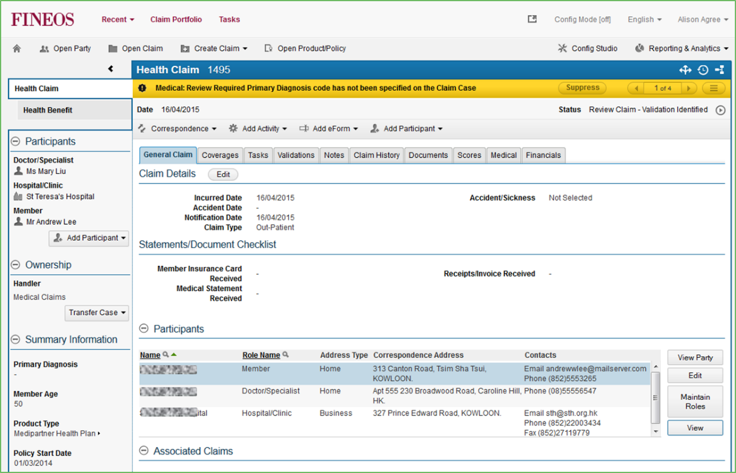
Human Interaction Vertical
FINEOS UI Components
Utilities
Operations
Admin
Summary Panel
Zone Info & Actions
Zone Content
Widget

Slide 57
Human Interaction Vertical
Human Interaction Components
# | Principle
1 | Build for consistency across interaction touch points and device type
2 | Consider the full user experience
Comply to AXA Brand & Digital Business Guideline and AXA Asia Web / Mobile Design Guidelines to define standard reusable set of UI
Vendor Portal / Mobile App must comply to AXA Asia Web / Mobile Design Guidelines
Health Claims Portal
TPA
Provider Portal
Legend
Portal
Custom Build
1
Mobile Application
2
TPA Systems
3
Portal
4
Out of scope
EIP
FINEOS
# | Component | Description
1 | Health Claims Portal | As an initiative under the “Customer Satisfaction” strategic pillar, portal development is under progress.
2 | Mobile Application | As an initiative under the “Customer Satisfaction” strategic pillar, mobile application development is under progress.
3 | TPA Systems | Out of scope; however, services will be created for future integration to support claims related function e.g. pre-approval and claims tracking
4 | Provider Portal | Out of scope; however, services will be created for future integration to support claims related function e.g. pre-approval and claims tracking

Slide 58
Services Vertical
AXA Service Definition & Services
Interaction Services
EIP
Process Services
Manage Documents
Output Processing
…
Services
Functional Services
Record Claim
Record Payment
…
Information Services
Retrieve Policy
Retrieve Member
…
Reuse shared service provided by AXA
New instance of existing service provided by AXA
New instance of new service provided by AXA
Provider external to AXA

Slide 59
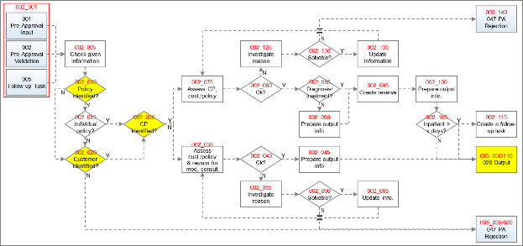

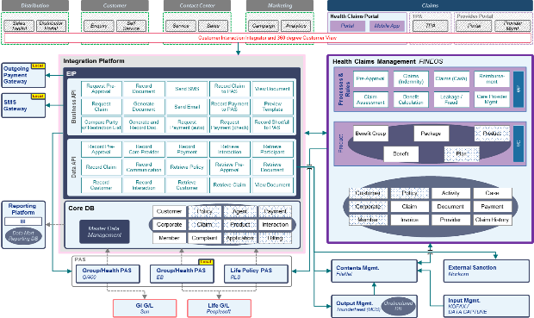
Services Vertical
Service Definition Approach
Bottom-up Approach
Reviewed all business processes at the business activity level
Defined ‘Responsibles’ of activities to determine if integration is required
For each activity marked system related, defined business services with source/target systems, type of data, details, and frequency
Achieve exclusiveness & exhaustiveness of service definitions
Top-down Approach
Defined AXA Asia Target Architecture based on business initiatives and corporate strategies
Defined integration points from an architectural-point of-view
Defined business API, data APIs based on the nature of integration

Slide 60
Services Vertical
Service Catalog (1/4)
ID | Service Name | Source | Target | Data | Description | Frequency
DB-01 | Record Pre-Approval | FINEOS | Core DB | Pre-Approval Data | Create a reference number and pre-approval number for pre-approval generated by FINEOS Update status of pre-approval (via pre-approval number) on Core DB | Real-time
DB-03 | Record Claim | FINEOS | Core DB | Claim Data | Create a reference number and claim number for claim generated by FINEOS Update status of claim (via claim number) on Core DB | Real-time
DB-05 | Retrieve Policy | Core DB | FINEOS | Policy Details | Retrieve policy data from Core DB via policy / member number policy header benefit structure from policy / product on policy premium payment / shortfall information special conditions on policy (exclusions, amendments, pre conditions) | Real-time
DB-06 | Retrieve Member | Core DB | FINEOS | Member Details | Retrieve member details from Core DB via policy / member number member & member group special conditions on members (e.g. segment) | Real-time
DB-07 | Record Care Provider | FINEOS | Core DB | Care Provider Details | Record care provider details to Core DB via policy / member number care provider & care provider group | Asynchronous
DB-08 | Retrieve Participant | Core DB | FINEOS | Participant Contact | Retrieve participant(s) contact information (member, care provider, agent, corp. HR) from Core DB via policy / member number | Real-time

Slide 61
Services Vertical
Service Catalog (2/4)
ID | Service Name | Source | Target | Data | Description | Frequency
DB-09 | Record Communication | FINEOS | Core DB | Communication Instance Data | Create instance data for each output sent with document ID | Real-time
DB-10 | Record Payment | FINEOS | Core DB | Payment Information | Record payment information on Core DB payment info on claim participant(s) and their contact info (member, CP, panel, HR) payment status information consignment number | Real-time
DB-11 | Record Interaction | FINEOS | Core DB | Customer Interaction Instance Data | Create customer interaction instance data in Core DB | Real-time
DB-12 | Record Customer | FINEOS | Core DB | Customer Data | Record new member under group policy upon new claim, the member is created as an individual customer to Core DB | Real-time
FE-01 | Request Pre-Approval | Portal / eFax | FINEOS | Pre-Approval Registration | Capture pre-approval data from portal / eFax to ensure sufficient information is provided to open the pre-approval case in FINEOS | Real-time
FE-02 | Request Claim | Portal / eFax | FINEOS | Claim Registration | Capture claim data from portal / eFax to ensure sufficient information is provided to open the claim case in FINEOS | Real-time
FE-03 | Retrieve Interaction | Portal / Mobile | Core DB | Customer Interaction Instance Data | Retrieve customer interaction instances from 360 upon request by customer | Real-time
FE-04 | Retrieve Pre-Approval | Portal / Mobile | Core DB | Pre-Approval Data | Retrieve pre-approval data from 360 upon request by customer | Real-time
FE-05 | Retrieve Claim | Portal / Mobile | Core DB | Claim Data | Retrieve claims data from 360 upon request by customer | Real-time

Slide 62
Services Vertical
Service Catalog (3/4)
ID | Service Name | Source | Target | Data | Description | Frequency
FN-01 | Record Document | FINEOS | FileNet | Pre-Approval / Claim Documents | Create and index pre-approval / claim documents (+metadata) in FINEOS and store in FileNet | Asynchronous
FN-02 | Retrieve Document | FINEOS | FileNet | Pre-Approval / Claim Documents | Read and download pre-approval / claim documents (+metadata) stored in FileNet link pre-approval / claim ID with doc. ID | Asynchronous
FN-03 | Generate and Record Document | FINEOS | FileNet | Document data | Orchestration service to create output data in MCS and store in FileNet (+metadata) | Real-time
MC-01 | Generate Document | FINEOS | MCS | Output Data | Create output data in output solutions to trigger, edit, preview output correspondences in FINEOS | Real-time
MC-02 | Preview Document | MCS | FINEOS | Document Template Previews | Create output template previews for output method selection in FINEOS | Real-time
EM-01 | Send Email | FINEOS | Email Gateway | Email Correspondence | Trigger output solutions to send out Email correspondences | Real-time
SM-01 | Send SMS | FINEOS | SMS Gateway | SMS Correspondence | Trigger output solutions to send out SMS correspondences | Real-time

Slide 63
Services Vertical
Service Catalog (4/4)
ID | Service Name | Source | Target | Data | Description | Frequency
PA-01 | Record Claim to PAS | FINEOS | PAS | Claim Data | Create claim reference to PAS to updated accounting and general ledger upon payment | Asynchronous
PA-02 | Record Payment to PAS | FINEOS | PAS | Payment Information | Record payment information on PAS payment info on claim participant(s) and their contact info (member, CP, panel, HR) payment status information consignment number | Asynchronous
PA-03 | Record Shortfall to PAS | FINEOS | PAS | Shortfall Information | Record shortfall information to PAS shortfall info on claim participant(s) and their contact info (member, CP, panel, HR) shortfall status information | Real-time
PY-01 | Request Payment (autopay) | FINEOS | Payment Gateway | Payment (autopay) Information | Request for payment with payment details (auto) payment info on claim participant(s) and their contact info (member, CP, panel, HR) payment details (amount) | Asynchronous
PY-02 | Request Payment (check) | FINEOS | Finance | Payment (check) Information | Request for payment with payment details (check) payment info on claim participant(s) and their contact info (member, CP, panel, HR) payment details (amount) | Batch
NK-01 | Compare Party w/ Restriction List | FINEOS | External Sanction | Party Black List Data | Read black list information from external sanction (Norkom) and retrieve results send party black list information (name) to compare with Norkom database receive black list comparison result for party | Real-time

Slide 64
Information Vertical
Information Framework
Business Architecture
Business Object Model
Information
Model
Enterprise Information
Model
AXA Information
Model
AXA OpCo Business Process & other business standards
Logical data Models
Information
Services
Master Data Management
Meta Data Management
Real-Time & Big Data
Analytics
Business Object services
Search services
Core Data Services
Data Structure
Profiles
Mapping, Matching and transform rules
Data Models
Data Recovery Services
Data Governance
Data Quality Management
Data lifecycle management
Data Stewardship
Information Stores
Application Data Stores
Unstructured Data
Operational Data Stores
Master Data Stores
Data Warehouse
BI Data Marts
Big Data
Reuse shared service provided by AXA
New instance of existing service provided by AXA
New instance of new service provided by AXA
Provider external to AXA

Slide 65
Information Vertical
High level architecture setup (claims view) to define master data per application and data requirement via interfacing (without integration layer e.g., Core DB)
Health Claims Management
Core DB
Feed customer, member, and policy information into Health Claims Management
Master data of:
Benefits
Benefit conditions
Network
Claims
Claims bookings
Master data of:
Customer / Member
Interaction
Interfaces data of:
Policy
Feed benefits to Product Configurator
Feed policy information to Core DB
Product Configurator
Policy Admin System
Feed product, plan, package information to Policy Admin Systems
Product design using benefits from claims system
Master data of:
Policy
Premium
Supporting product design process, decoupled of claims project

Slide 66
Information Vertical
Data owner of all definitions is the product development team, the benefit schedule definition will be stored claims system.
Product Benefit Structure:
Application Data Master
Application Data Usage
Product
Product Configurator
used to configure product, plan and package
G400
RLS
Claims System
Rider
Plan
EB
Package
Benefit Group
Benefit ID, Title
Claims System used to configure benefit and benefit condition
Benefit Condition
currently only partially used, but will not be used anymore in the future

Slide 67
Information Vertical
Customer 360 and Master Customer Data Management
FINEOS
EIP
Core DB
Biz Process | Interaction with MDM & Core DB
Pre-approval Registration | Find customer and policy details from MDM and Core DB. Customer information can be used to pre-populate claim record in FINEOS. Update customer demographic and care provider details in MDM as needed.
Claim Registration | Submitted claim record is copied to Core DB and linked to the customer via the master customer ID.
Claim Validation | Claim-related interactions are copied to Core DB and linked to the customer via the master customer ID.
Person
Policy
Corporate
Claim Benefit
Customer
Claim
Claim Key Status
Inter -action
Service Request
Mobile Application / Customer Portal / Call Center
MDM
Reporting DB
Biz Process | Interaction with MDM & Core DB
Claim status inquiry | Upon identifying customer record, customer / distributor / call center operator can further retrieve related policies and claims of the customer from Core DB.
BI / Analytics
Biz Process | Interaction with MDM & Core DB
Claim Performance & Reporting | Support operation to understand the claim performance and operation efficiency.

Slide 68
Integration Vertical
Integration Framework
Interaction Touch points
Portal Services & multi-access enablers / Interaction services
Data Protection
Business Process Management / Process Services
Integration
Orchestration (process / workflow)
Registry / Repository
Mediation / Gateway
Payload validation
Logging
Service Quality
Service / meta data lookup
Security Services
Routing Optimization
Service Quality Management
Monitoring & Management
Routing Endpoint resolution
Tracing / Tracking
Service Visualization (proxy)
Authentication
Service / meta data management
Adaptation
Logical processing
Application adaption
Transformation
Payload transformation
Meta data transformation
Versioning support
Internationalization / localization
Data enrichment
Data adaption
Transportation
Federated repository
Authorization
Bridging protocol
Transport bindings
Standard exchange patterns
Information Services
Core data services
Meta Data Management
Master Data Management
Real-Time & BigData Analytics
Business Object services
Search services
Reuse shared service provided by AXA
New instance of existing service provided by AXA
New instance of new service provided by AXA
Provider external to AXA

Slide 69
Integration Vertical
High Level Integration Map of FINEOS
Security
TPA
Health Claims Portal / App
Authoization
(SiteMinder)
EIP
(Software AG webMethods)
Output Mgmt. (MCS, Thunderhead)
PAS (RLS)
Health Claims Administration
(FINEOS)
Security Policy
(SiteMinder
Policy Server)
Content Mgmt.
(FileNet)
Input Mgmt.
(Local)
Life G/L
(Peoplesoft)
WAF
(F5)
PAS (EB)
Email GW
(Cisco Ironport)
GI G/L
(Sun)
SMS GW
(Local)
ESG
(CA Layer 7)
PAS
(G/400)
Payment GW (Local)
Employee Directory
(GIR)
ETL
(Informatica)
Legend
User Mgmt.
(Pass AXA)
Core DB
(Oracle DBMS)
Real time (EIP)
New
Report DB
(SAS, Qlikview)
External Sanction
(Norkom)
Batch (ETL)
Existing
MDM
(Informatica)
Data int,
Integration

Slide 70
Integration Vertical
Integration Patterns (1/2)
# | Principle
1 | Exclude business logic from integration
2 | Encapsulate data format transformation logic in a specific repository
Highlight integration patterns that are key to claims processing and presenting high level of change from As-Is patterns
Define specific details and potential differentiations based on method of input and/or output
Increase implementation efficiency as design is standard/repetitive
# | Integration Scenario | Integration Details
1 | Claim Registration (Paper) | Input Mgmt. system captures images and store images into Content Mgmt. system. Input Mgmt. system recognizes form type from barcode. Indexing Operator validates system recognized data if required. And Index Operator adds additional metadata into Input Mgmt. system. Input Mgmt. system stores image with metadata into Content Mgmt. system. Storing image into Content Mgmt. system triggers event to start workflow. Workflow in Content Mgmt. system triggers event to EIP to create case in FINEOS. Once Data Entry Operator records claim data into FINEOS, FINEOS records claim information into Core DB.
2 | Claim Registration (Email / Fax) | Data Entry Operator can create claim case in FINEOS and upload images from file system into FINEOS. Data Entry Operator enters claim registration data into FINEOS. Claim registration data in FINEOS will become metadata for document. Document image will be stored into Content Mgmt. system with metadata. Once claim registration data is recorded into FINEOS, FINEOS records claim data into Core DB.
3 | Claim Registration (Mobile App / Portal) | Customer can request claim via Customer Portal or Health Claims Mobile app. Customer provides photocopy of document image. Request Claim API creates case and submit the claim registration information into FINEOS.
4 | Record Group Customer (Mobile App / Portal) | Customer with group policy submits claim through mobile app / customer portal. Along with claims registration data, FINEOS records group customer as individual customer then records customer information into Core DB.
 | Record Group Customer (Email / Fax / Letter) | Customer with group policy submits claim through email / fax / letter. Data Entry Operator creates claim case and enters individual customer data into FINEOS. Along with claims registration data, FINEOS records group customer as individual customer then records customer information into Core DB.

Slide 71
Integration Vertical
Integration Patterns (2/2)
# | Integration Scenario | Integration Details
4 | Status Inquiry | Through the course of the claims process, FINEOS needs to update claim, communication, interaction and payment information into Core DB so that Connect IT Front End applications can retrieve information from Core DB.
5 | Claim Assessment | FINEOS retrieves customer information from MDM and Core DB. FINEOS retrieves policy and claims information from Core DB. Then FINEOS runs claims assessment rules. FINEOS refers to international sanctions list for black listing care providers, members etc.
6 | Payment (Real-time) – customers | For real-time payment, FINEOS should be able to integrate directly to Payment Gateway via EIP in order to reduce Turn Around Time of claims payment. At the same time, FINEOS should record payment information into Policy Administration Systems for record keeping of accounting information.
7 | Payment (Batch) –providers and hospitals | For batch payment, FINEOS should be able to integrate directly to Payment Gateway via EIP with agreed payment schedules with the care providers and hospitals to eliminate any inefficiencies caused through micro-payments. At the same time, FINEOS should record payment information into Policy Administration Systems for record keeping of accounting information.
8 | General Ledger | FINEOS should record payment information into Policy Administration Systems for record keeping of accounting information. Policy Administration System already has integration to interface accounting information into General Ledger system.
9 | Send Email / Send SMS | FINEOS should record Interaction data into Core DB when it sends notice to customer. FINEOS should send SMS or Email via EIP.

Slide 72
Integration Vertical
Scenario 1: Claim Registration (Paper)
Input Mgmt. system captures images and store images into Content Mgmt. system. Input Mgmt. system recognizes form type from barcode.
Indexing Operator validates system recognized data if required. And Index Operator adds additional metadata into Input Mgmt. system. Input Mgmt. system stores image with metadata into Content Mgmt. system.
Storing image into Content Mgmt. system triggers event to start workflow. Workflow in Content Mgmt. system triggers event to EIP to create case in FINEOS.
Once Data Entry Operator records claim data into FINEOS, FINEOS needs to record claim information into Core DB.
Paper Form
Scanning Operator
Indexing Operator
Data Entry
Operator
Input Mgmt.
Kofax / FileNet Capture / IBM Data Capture
Health Claims Management
FINEOS
<<user>>
Scan/Upload
<<system>>
Enhance
<<system>>
Recognize
<<user>>
Validate
<<system>>
Index
<<system>>
Store
<<system>>
Create Case
<<user>>
Retrieve
Image¹⁾
…
<<user>>
Register
Claim
 | Principle | Description
1 | Record and update claim status into Core DB | Claim status should be updated in Core DB so that Connect IT Front-Ends application can get up-to-date claim status from Core DB.
2 | Store document image into single Content Management System | Document should be stored in the regional Content Management system so that FINEOS has single interface to retrieve and record images.
Store document with index:
Form Type, Policy Number, Customer ID, etc
Retrieve document with unique ID
EIP
Software AG webMethods
Request Claim
Retrieve Document
Record Claim
Content
Mgmt.
IBM FileNet
SOA/Business Service Catalogue
EIP
Record Document
Retrieve Document
Core DB
Oracle
Claim
FINEOS has the capability provide a call-out link for images from FileNet, allowing users to access documents without the physical retrieval but in a form of a viewer

Slide 73
Integration Vertical
Scenario 2: Claim Registration (Email / Fax)
Data Entry Operator can create claim case in FINEOS and upload images from file system into FINEOS. Data Entry Operator enters claim registration data into FINEOS.
Claim registration data in FINEOS will become metadata for document. Document image will be stored into Content Mgmt. system with metadata.
Once claim registration data is recorded into FINEOS, FINEOS records claim data into Core DB.
Unstructured
Email Attachment
Unstructured
Fax Image
Data Entry Operator
Health Claims Management
FINEOS
Index¹⁾
Store¹⁾
<<user>>
Create Case
<<user>>
Scan/Upload
<<user>>
Register
Claim
<<system>>
Index
<<system>>
Store
…
EIP
Software AG webMethods
Record Claim
Record Document
EIP
Content
Mgmt.
IBM FileNet
Core DB
Oracle
Claim
Record Document
FINEOS has the capability to index and store attachments from FINEOS which allows processing along with case creation

Slide 74
Integration Vertical
Scenario 3: Claim Registration (Mobile Application / Customer Portal)
Customer
Customer can request claim via Customer Portal or Health Claims Mobile app. Customer provides photocopy of document image.
Request Claim API creates case and submit the claim registration information into FINEOS.
Customer Portal / Mobile App
Request Claim
 | Principle | Description
1 | Protect API with ESG | All the services exposed to cloud should be protected by ESG.
2 | Provide APIs to Connect IT Front Ends via EIP | EIP should provide APIs to cloud reading and updating Core DB data, and connecting to business applications.
Service Gateway CA Layer 7
EIP
Software AG webMethods
Request Claim
Record Document
Health Claims Management
FINEOS
<<system>>
Create Case
<<system>>
Register
Claim
…
EIP
Software AG webMethods
Record Claim
Content Mgmt.
IBM FileNet
Core DB
Oracle
Claim
Record Document

Slide 75
Integration Vertical
Scenario 4: Record Customer (Group Policy Customers)
1
Group Policy Customer
Group Policy Customer claim through Mobile App / Portal
Customer with group policy submits claim through mobile app / customer portal.
Along with claims registration data, FINEOS records group customer as individual customer then records customer information into Core DB.
Group Policy Customer claim through Email / Fax / Letter
Customer with group policy submits claim through email / fax / letter.
Data Entry Operator creates claim case and enters individual customer data into FINEOS.
Along with claims registration data, FINEOS records group customer as individual customer then records customer information into Core DB.
2
Customer Portal / Mobile App
Request Claim
Email / Fax / Letter
Service Gateway CA Layer 7
EIP
Software AG webMethods
Create Case
Data Entry Operator
Health Claims Management
FINEOS
STP
Manual Process
<<system>>
Create Case
<<system>>
Register
Claim
…
<<user>>
Create Case
<<user>>
Input Customer Information
…
<<system>>
Register Claim
…
EIP
Software AG webMethods
Record Claim
Record Customer
Record Claim
Record Customer
Core DB
Oracle
Claim
Customer

Slide 76
Integration Vertical
Scenario 5: Status Inquiry
Through the course of the claims process, FINEOS needs to update claim, communication, interaction and payment information into Core DB so that Connect IT Front End applications can retrieve information from Core DB.
Customer Portal
Servicing CRM
Mobile App
Retrieve Claim
Retrieve Interaction
 | Principle | Description
1 | Record and update customer interaction into Core DB | Customer Interaction information should be updated in Core DB so that Connect IT Front-Ends application can get all the customer interaction data from Core DB.
Service Gateway CA Layer 7
EIP
Software AG webMethods
Retrieve Claim
Retrieve Interaction
Health Claims Management
FINEOS
Register Claim
Validate Claim
Assess Claim
Payment
Notify Customer
EIP
Software AG webMethods
Record Claim
Record Interaction
Record Payment
Record Comm.
Core DB
Oracle
Claim
Interaction
Payment
Comm.

Slide 77
Integration Vertical
Scenario 6: Claim Assessment
FINEOS retrieves customer information from MDM and Core DB. FINEOS retrieves policy and claims information from Core DB.
Then FINEOS runs claims assessment rules.
FINEOS refers to Norkom for international sanctions list of black listing care providers, members etc.
Health Claims Management
FINEOS
Retrieve Customer
Compare Party w/ Restriction List
Retrieve Policy
Retrieve Claim History
Apply Claim Assessment Rule
EIP
Software AG webMethods
Retrieve Customer
Compare Party w/ Restriction List
Retrieve Policy
Retrieve Claim
External Sanction
Norkom
Party Analysis
Core DB
Oracle
Customer
Policy
Claim
MDM – Master Data Management

Slide 78
Integration Vertical
Scenario 7: Payment (Real-time) – direct customers
For real-time payment, FINEOS should be able to integrate directly to Payment Gateway via EIP in order to reduce Turn Around Time of claims payment.
At the same time, FINEOS should record payment information into Policy Administration Systems for record keeping of accounting information.
Payment Gateway Provider
Service Gateway CA Layer 7
Health Claims Management
FINEOS
EIP
Software AG webMethods
Payment Gateway Service
…
<<system>>
Payment
…
<<system>>
Record status
Straight through payment processing
Payment status
EIP
Software AG webMethods
Record Payment
Record Payment to PAS
Life Policy
Admin
RLS
Group
Policy
Admin
G/400
Group Policy
Admin
EB
Core DB
Oracle
Payment

Slide 79
Integration Vertical
Scenario 7: Payment (Batch) – providers and hospitals
For batch payment, FINEOS should be able to integrate directly to Payment Gateway via EIP with agreed payment schedules with the care providers and hospitals to eliminate any inefficiencies caused through micro-payments.
At the same time, FINEOS should record payment information into Policy Administration Systems for record keeping of accounting information.
Payment Gateway Provider
Service Gateway CA Layer 7
Health Claims Management
FINEOS
EIP
Software AG webMethods
Payment Gateway Service
Batch process (over night)
…
<<system>>
Record payment due
…
<<system>>
Retrieve payment due
<<system>>
Payment
…
<<system>>
Record status
Batch payment processing
Payment status
Payment Due
EIP
Software AG webMethods
Record Payment
Record Payment to PAS
Life Policy
Admin
RLS
Group
Policy
Admin
G/400
Group Policy
Admin
EB
Core DB
Oracle
Payment

Slide 80
Integration Vertical
Scenario 8: General Ledger
FINEOS should record payment information into Policy Administration Systems for record keeping of accounting information.
Policy Administration System already has integration to interface accounting information into General Ledger system.
Health Claims Management
FINEOS
Register Claim
…
Payment
…
EIP
Software AG webMethods
Record Claim to PAS
Record Payment to PAS
Group Policy
Admin
G/400
Life Policy
Admin
RLS
Group Policy
Admin
EB
General Ledger
Sun
General Ledger
Peoplesoft

Slide 81
Integration Vertical
Scenario 9: Send Email / Send SMS
FINEOS should record Interaction data into Core DB when it sends notice to customer.
FINEOS should send SMS or Email via EIP.
SMS
Gateway
Local
Email
Gateway
Cisco Ironport
EIP
Software AG webMethods
Send SMS
Send Email
Health Claims Management
FINEOS
FINEOS Email Integration Mechanism
Claims Agent
External Agent
…
<<system>>
Record Interaction
<<system>>
Send SMS
<<system>>
Send Email
…
FINEOS Claims Management
Mail Service
Claim
Mail Client
Documents
SMTP
Email
To: Customer
Bcc: FINEOS Outound
From: Users Outlook Account
Subject: Party: 27, Case: B12345
Interactions
Record Interaction
…
Claims Mailbox
EIP
Software AG webMethods
Mail
Processing
WS
Email
To: FINEOS Contact Address
From: External User
From: Users Outlook Account
Subject: Party: 27, Case: B12345
Document Management
FINEOS keeps a list of correspondences both inbound/outbound email on a customer or case
Application BCCs in/outbound email to itself to recognize emails received/sent in a customer or case view and link to keep
Outbound server is configured in FINEOS email
User email will be triggered from user account vs. FINEOS generated emails will directly be triggered by system SMTP
Core DB
Oracle
Interaction

Slide 82
Monitoring & Management Vertical
Monitoring and Management Framework (MMF)
Business Arch.
Business Activity Monitoring
Service Quality Management
IS Architecture Application and Data Frameworks
Application Management
Data Management (Structured/ Unstructured)
Operations Management
Reporting and Analysis
Inventory Services & Components
Automation
Control
Monitoring
Deploy
Configure
Application Monitoring
Log Collection & Diagnosis
Collect & Store
Capacity Planning
Tune
Discovery & Mapping
Performance Availability
Consistency & Validation
Provision, Reprovision & Configure
Incident Recording
Real-time Historical Trend
Log Collection & Diagnosis
Policy based Operations & Run books
Job Control
Service Operations Monitoring
Resource Usage
Infrastructure Architecture
GTA Infrastructure Framework Services
Technical Management
Capacity Planning
Job Scheduling
Output & Dispatch
Data Mining, Profiling & Analytics
Inventory Services & Components
Archive & Retrieve
Process Orchestration
Deploy
Retention & Purge
Configure
Infrastructure Monitoring
Log Collection & Diagnosis
Protection
Resource Optimization
Capacity Planning
Performance Availability
Legend:
Reuse shared service provided by AXA
New instance of existing service provided by AXA
New instance of new service provided by AXA
Provider external to AXA

Slide 83
Monitoring & Management Vertical
Service Quality Requirements (SQR)
ITIL Category | NFR | Value
Availability | Service Hours | API will require 24/7 uptime
Availability | Peak Hours / Critical Periods | FINEOS will be mostly used during office hours of the included countries. The time zone span will be form UTC+5:30 to UTC+8. Assumed Core Period is from Monday UTC 02:30 to UTC 12:00
Operations & Tech Services | Extensibility & Scalability | An extendable architecture will be required. Virtualization is the most ideal architecture for FINEOS.
Operations & Tech Services | Maintainability | Configuration of business rule shall be maintained by business users as per FINEOS's standard architecture.
Operations & Tech Services | Reusability & Convergence | Existing architecture especially in relation to interfaces and architecture principles should be reused whenever possible.
Performance | Performance | FINEOS will require at most a 3 seconds to complete an acknowledgement message
SQR File:

Slide 84
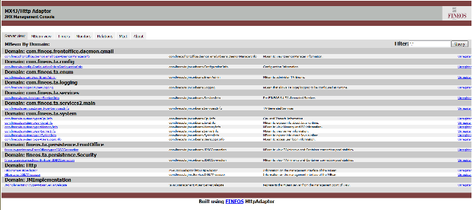
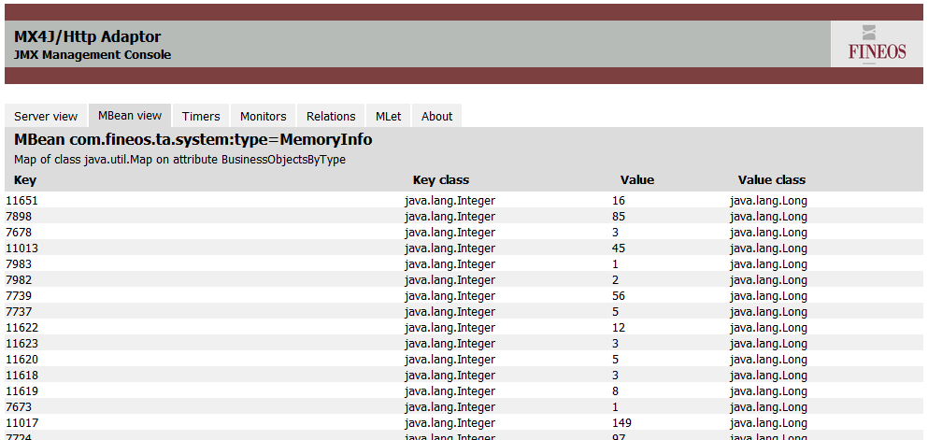
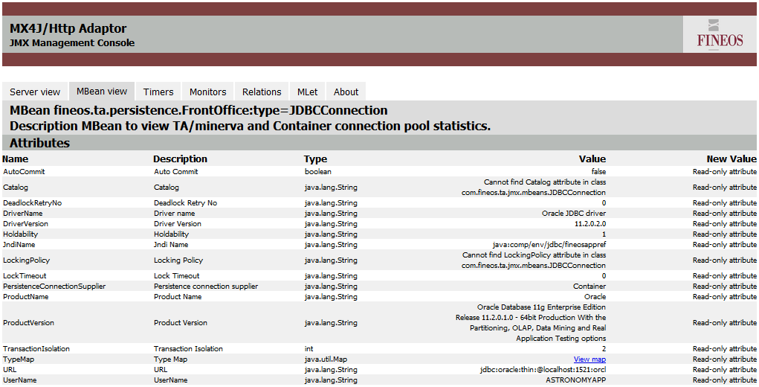
Monitoring & Management Vertical
FINEOS Monitoring Capabilities (Internal JMX Console)
FINEOS Internal JMX console – home page
Java Management Extensions (JMX) MBeans – standard technology for managing and monitoring applications
Provides a detailed ‘inside’ view of system
Data includes number sessions, session data, number of business entities, etc.
Performance Alerts for performance monitoring and capacity planning
Alert technology: log4j; logs for all potential tasks and actions that are alert worthy
Logging is enabled to be configurable for extensive logging levels (e.g. can turn on only request statistics logging)
Alert for requests and returns (e.g. web request, database request, database request returns) over a pre-defined time will be logged as an alert
MBean – MemoryInfo
(count of each logical entity in memory - claim, case, person etc.)
MBean – JDBCConnection
Details of the primary connection pool used by the application

Slide 85

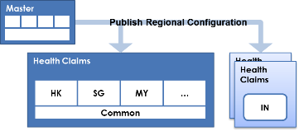
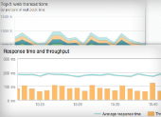


Monitoring & Management Vertical
Production Diagnostics in the Cloud
Security Review is required for Cloud Diagnostic Model
Diagnostic Information
Production Environment
FINEOS Diagnosis Team
Diagnosis on issues
Data center has access to the deployment to monitor and diagnose the production by FINEOS expert team
Black box concept : FINEOS will have access to the actual diagnostic results, not AXA
Live servers deliver diagnostic information to the cloud real-time
General information of diagnostics
Customer data is not sent to cloud
FINEOS experts can access diagnostic data in real time to enable faster resolution of issues
Important for critical and intermittent problems where the root cause is not clear (e.g. HW, app server, app, DB, integration, NW)
Leverages specialist technology skills in FINEOS

Slide 86
Entity Specific Architecture – Hong Kong

Slide 87
Entity Specific Architecture – Hong Kong
Health Claims Architecture
Distribution
Customer
Contact Center
Marketing
Claims
Sales Toolkit
DLFE/iPr
Distributor
Portal
SFDC
Customer Portal
Health Claims Portal
Mobile App
AXA@Work
TPA
Provider Portal
Enquiry
Self
Service
Service
Sales
Campaign
Analytics
Portal
Mobile App
Customer Interaction Integrator and 360 degree Customer View
Outgoing
Payment
Gateway
Integration Platform
Health Claims Management FINEOS
EIP
Processes & Rules
Business API
Pre-Approval
Claims (Indemnity)
Claims (Cash)
Reimburse-ment
Request Pre-Approval
Record Document
Send SMS
Record Claim to PAS
View Document
Request Pre-Approval
MP
SMS
Gateway
Request Claim
Generate Document
Send Email
Record Payment to PAS
Preview Template
Claim Assessment
Benefit Calculation
Leakage / Fraud
Care Provider Mgmt.
Compare Party w/ Restriction List
Generate and Record Doc.
Request Payment (auto)
Request Payment (check)
Record Shortfall to PAS
Product
Benefit Group
Package
Product
Data API
MC
Record Pre-Approval
Record Care Provider
Record Payment
Retrieve Interaction
Retrieve Participant
Benefit
Plan
Record Claim
Record Communication
Retrieve Policy
Retrieve Pre-Approval
Retrieve Document
Record Customer
Record Interaction
Retrieve Customer
Retrieve Claim
View Document
Customer
Policy
Activity
Case
Reporting
Platform
Core DB
Corporate
Claim
Document
Payment
Customer
Policy
Agent
Payment
Member
Invoice
Provider
Claim History
BI
Master Data
Management
Corporate
Claim
Product
Interaction
Data Mart
Reporting DB
Member
Complaint
Application
Billing
PAS
Contents Mgmt.
FileNet
External Sanction
Norkom
Group/Health PAS
G/400
Group/Health PAS
EB
Life Policy PAS
RLS
Unstructured
DB
GI G/L
Sun
Life G/L
Peoplesoft
Output Mgmt.
Thunderhead (MCS)
Input Mgmt.
KOFAX / DATA CAPTURE
API Integration
Data Integration
Out-of-scope component
Capability
Data Element (Master Data)
Data Element (Interfacing Data)
Local
Local Component

Slide 88
Entity Specific Architecture – Hong Kong
Application Landscape Details
No | Category | Solution Component | Technical Component | LoB | Region / Local | Comments
1 | Business Application | Life Policy Admin | RLS | Life | R
2 | Business Application | Group Policy Admin | EB | GI | L
3 | Business Application | Group Policy Admin | G400 | GI | L
4 | Business Application | General Ledger | PeopleSoft | Life | R
5 | Business Application | General Ledger | Sun Accounting | GI | R
6 | Peripheral Application | Payment Gateway | RDB | Life | L | For encryption of outgoing payment file only
7 | Peripheral Application | Payment Gateway | N/A | GI | N/A | No system currently use for payment, manual processing
8 | Peripheral Application | Reporting | SAS EG/VA | Life / GI | R
9 | Peripheral Application | Email Gateway | N/A | Life / GI | N/A | No solution in HK yet
10 | Peripheral Application | SMS Gateway | Smartone (manual) | Life / GI | L | Automated SMS Gateway Provider is sourcing for all HK entities
11 | Peripheral Application | Content Management | FileNet 4.5 Kofax (scanning) | Life | R / L
12 | Peripheral Application | Content Management | FileNet 4.5 FileNet Capture Data Capture | GI | R / L | To be decommissioned
13 | Peripheral Application | Content Management | GTOM FileNet 5 | GI | R / L
14 | Front-End Application | Customer Touchpoint | e-life (website) | Life | R
15 | Front-End Application | Customer Touchpoint | AXA@Work | GI | R
16 | Front-End Application | Distributor Touchpoint | iPro (Mobile App) SFDC (Distributor Portal) | Life | R
17 | Front-End Application | Health Claims Portal | Health Claims Portal | GI | R
18 | Front-End Application | Servicing CRM | SFDC | Life | R | To be launched in Q4 2015
19 | Front-End Application | Servicing CRM | SFDC | GI | R | To be launched in Q1 2016

Slide 89
Entity Specific Architecture – Hong Kong
Through verification with HK Life / GI users, project team was able to extract key consideration points specific for the Hong Kong entity.
Topic | Components | Details
Payment Separation | - | Hong Kong accounts for the Macau market as well → health claims system is to be able separate payments
Payment Process | Payment automation | Payment processes are executed in a manual manner (manual generation of files, input, issuance of checks etc.)
 | System variation for process | Life payment process involved RDB to encrypt pay link files whereas GI payment process does not
 | Bank affiliations | Life payment bank: Citibank GI payment bank: HSBC Life / GI engaged their respective banks for both check and auto pay transactions
 | Payment types | Life payment types: (system processing) Bank deposit, Check (manual transactions) Remittance, UnionPay (for credit cards and banks in China) GI payment types: (system processing) Bank deposit, Check (manual transactions) Remittance

Slide 90
Entity Specific Architecture – Hong Kong
Hong Kong Payment (Life) Process
RLS
Generate pay link files to check and auto pay payments
Update check number
RDB
Encrypt the generated files from RLS
Generate file for RLS to update check number
Claim Users
Make decision on claim case and input into RLS
Download report from Citibank for check info
Operation Users
Upload to Citibank via Citibank web system
AXA Tech Support
Upload file to RLS
Citibank
auto pay or Check?
Carry out transaction
Autopay
Issue check and generate reports
Check

Slide 91
Entity Specific Architecture – Hong Kong
Hong Kong Payment (GI) Process
G400/EB
Generate pay link files to check and auto pay payments
While having a very similar process as Life payment, GI follows a 100% manual process and does not involve RDB to encrypt files, thus the RDB processes are omitted
Update check number
RDB
Encrypt the generated files from RLS
Generate file for RLS to update check number
Claim Users
Make decision on claim case and input into RLS
Download report from HSBC for check info
Operation Users
Upload to HSBC via HSBC web system
AXA Tech Support
Upload file to G400/EB
HSBC
auto pay or Check?
Carry out transaction
Autopay
Issue check and generate reports
Check

Slide 92
Program Roadmap

Slide 93
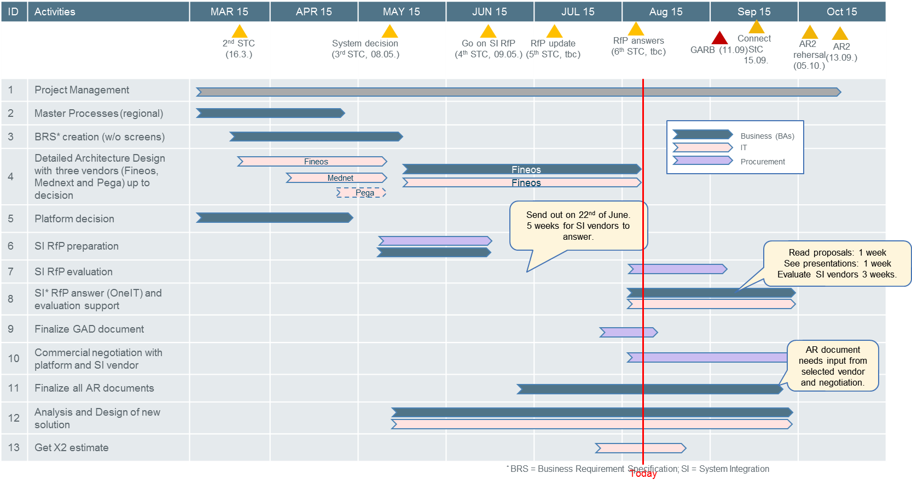
Program: Timeline – AR2 in October
Will be updated accordingly
(by biz team)
Planning based on assumption that platform decision will remain the same as recommended in 1st STC (Buy the Best Claims Platform in the Market NOT Build the Platform).

Slide 94
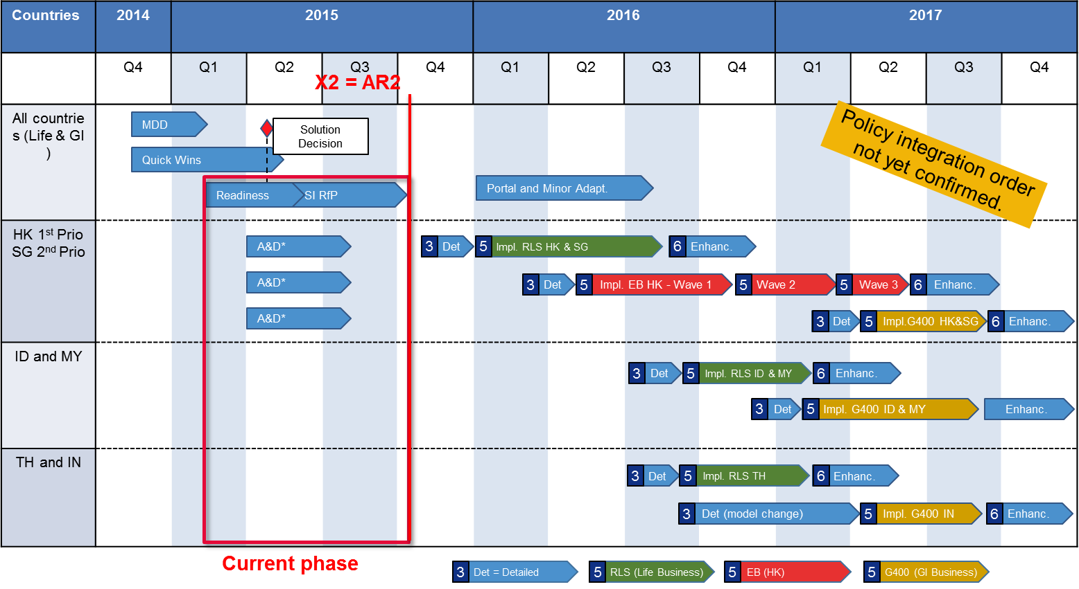
Program: Timeline – High Level
Will be updated accordingly
(by biz team)
To reach X2 and AR2 some analysis and design activities will be done for all legal entities and policy systems to ensure an accurate SI RfP evaluation.
* Entity assessment for Hongkong only
Notes:
To change bullet colors, select the text in question and go to the HOME menu > Bullets and numbers, choose "Custom bullet" and choose the desired bullet.
To insert the bullets to the PowerPoint bullet library, go to menu > Bullets and numbers, choose “bullets and numbering”, choose “picture”, choose import”, select the bullets’ folder previously saved on the hard drive and validate.

Slide 95
End of Document

